Slide 1


Wound Prevention and Care for Outreach and Direct Service Staff
Presenter:
Date:
Content developed by Billy Golden, Manager, NASTAD
Notes:
Presenters can add their name and date here.
It is recommended for presenters to schedule a break during presentation. Slide 41 is approximately halfway through the presentation and may be a good time for a break.

Slide 2
Content Developed by NASTAD
The content of this presentation was developed by NASTAD, which is a non-profit, non-partisan national association founded in 1992 that represents public health officials who administer HIV and hepatitis programs funded by state and federal governments.
NASTAD’s mission is to advance the health and dignity of people living with and impacted by HIV/AIDS, viral hepatitis, and intersecting epidemics by strengthening governmental public health and leveraging community partnerships.
The individual presenting this material may not be a representative of NASTAD and therefore any views expressed by the speaker do not necessarily reflect the official policies of NASTAD; nor does mention of trade names, commercial practices, or organizations imply endorsement by NASTAD.
Notes:
This slide acknowledges that the curriculum content was developed by NASTAD and shares a little bit about NASTAD as an organization. It acknowledges that the individual presenting the content may not be a NASTAD staff member or affiliate and therefore may not represent official NASTAD positions or policies.

Slide 3
Working with Communities
The SAMHSA-funded Opioid Response Network (ORN) assists states, tribes, organizations and individuals by providing the resources and technical assistance they need locally to address the opioid crisis and stimulant use.
Technical assistance is available to support the evidence-based prevention, treatment and recovery of opioid use disorders and stimulant use disorders.
Funding for this initiative was made possible (in part) by grant no. 1H79TI088037 from SAMHSA. The views expressed in written conference materials or publications and by speakers and moderators do not necessarily reflect the official policies of the Department of Health and Human Services; nor does mention of trade names, commercial practices, or organizations imply endorsement by the U.S. Government.

Slide 4
Working with Communities
The Opioid Response Network (ORN) provides local, experienced consultants in prevention, treatment and recovery to communities and organizations to help address this opioid crisis and stimulant use.
ORN accepts requests for education and training.
Each state/territory has a designated team, led by a regional Technology Transfer Specialist (TTS), who is an expert in implementing evidence-based practices.

Slide 5
We gratefully acknowledge that parts of this training have been collaboratively developed over the years by the many community members who have graciously shared their expertise, knowledge, and experience for the benefit of our communities.

Slide 6
Objectives:
Review current health guidance and first aid techniques for the prevention of wounds and other viral and bacterial health concerns.
Provide an overview of common injection-related health conditions.
Increase insight into xylazine-related wound care and prevention, based on current information.
Help empower your program participants to advocate for themselves in medical settings.
Notes:
Trainer notes:
This training does not constitute medical advice, however, we hope to help you learn more about potential health issues faced by people who are engaged in substance use, as well as possible first aid responses, and understand when more serious medical interventions may be necessary.
This training covers some basic health guidance and first aid for the prevention and treatment of wounds, common and less common injection related medical issues, xylazine wounds, and medical self advocacy.

Slide 7
Public Health Acronyms
PWH(A)​ | Person With HIV(/AIDS)​
HAV, HBV, HCV​ | Hepatitis A, B, C Virus​
HIV​ | Human Immunodeficiency Virus​
SSTI​ | Skin & Soft Tissue Infection​
STI​ | Sexually Transmitted Infection​
IDU | Injection Drug Use (as an action, not an identity)
SUD​ | Substance Use Disorder​
OUD​ | Opioid Use Disorder
MOUD/MAT​ | Medications for Opioid Use Disorder/Medication-Assisted Treatment​

Slide 8
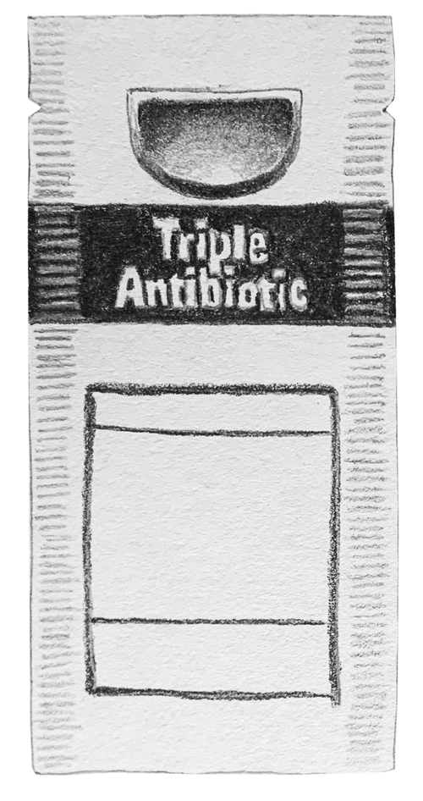
Suggestions for Wound Care Kit Supplies:
For programs seeking to distribute basic wound care kits, recommended supplies include:
Nitrile Gloves: to wear before changing dressing
Hand Sanitizer or Sanitizer Wipes: to disinfect hands
BZK Wipes: to clean wound and surrounding area
A and D Ointment: to apply around perimeter of wound
Antibiotic Ointment: to apply on top of the wound after cleaning and before applying dressing
Gauze: to dress the wound, non-adherent if possible
Adhesive bandage: to cover dressing
Image: www.zerostigma.art
Notes:
Trainer notes: what is in a wound care/first aid kit will vary based on program budgets as well as community needs. These are some suggested supplies for wound care kits. Some programs order prepackaged kits, while other programs assemble them in-house.

Slide 9

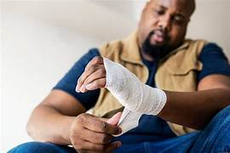
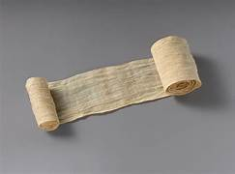
Dressings And Bandages
Dressings | Bandages
Comes into direct contact with the wound | May or may not be in direct contact with the wound
Gauze or other material placed directly on top of the wound | Used to support the dressing and keep it in place
Should be highly absorbent to absorb anything exuded from the wound (exudate) | Helpful if it is adhesive to better hold the dressing in place
May apply antibacterial solutions or other gels/ointments used to protect surface of wound | Should stay dry and as clean as possible. Can be applied quickly (such as an adhesive bandage)
Photos: Creative commons
Notes:
An adhesive strip, such as a “Band-Aid” is both a dressing and bandage.

Slide 10

Why is it important for direct service providers to understand the basics of wound care?
Photo: UW ADAI Empathy Lens Collection
Notes:
Trainer Notes:
This is an opportunity to engage your audience for a more interactive training.
Examples of answers could include:
Program participants trust us for advice/referrals/recommendations
To provide more comprehensive participant education
To better understand where to direct participants for medical care
You may want to also ask follow up questions. Examples could include:
What sort of service recommendations do your program participants ask for?
What are things program participants have taught you about how they care for themselves and their community?
Do program participants inform you of medical providers they have had good or bad experiences with?

Slide 11
What to Know:
This training is intended for service providers to have a general knowledge of some of the health issues that may result from injection drug use, for the purposes of prevention, care, and triage to other medical services.
Service providers may use this information to inform conversations with and education provided to program participants.
This information may also inform choices related to program inventory and supplies provision to participants.
Some symptoms, infections, or wounds may present similarly but have different causes or treatments. Recognizing the limitations of your knowledge is vital when providing participants with information about health issues they may be experiencing.
Notes:
Trainer notes:
This training does not constitute medical advice, however, we hope to help you learn more about potential health issues faced by people engaging in substance use, as well as possible first aid responses, and understand when more serious medical interventions may be necessary.
Service providers may be a trusted community resource, as such program participants may ask for guidance with health issues. Unless you are a medical professional, it is highly advised that you do not make any medical diagnosis. However, a basic knowledge of some of the health conditions that your clients/participants may face allows us to talk in more depth to participants about what is going on and mitigate further health risks.

Slide 12

Engaging with Participants
Approach with respect, curiosity, and compassion.
Ask informed questions.
Understand real-life conditions.
Use a risk reduction approach.
Understand that participants’ needs and priorities may change over time.
Provide timely information without judgement.
Be prepared to learn from your program participants.
Celebrate any positive change.
Photo: UW ADAI Empathy Lens Collection
Notes:
Trainer notes:
Acknowledge that participants experiencing medical issues are in a vulnerable position, and may be facing stigma related to their substance use or other identities/experiences/conditions
Learning about safer techniques and common practices in your community, including routes of administration
People may be using in a way that they know is unsafe or unideal—but it might be their current best option
Work with participants to identify opportunities to incorporate safer techniques or adopt more consistently healthy practices

Slide 13
Common Conditions and Concerns
Pictures start now

Slide 14
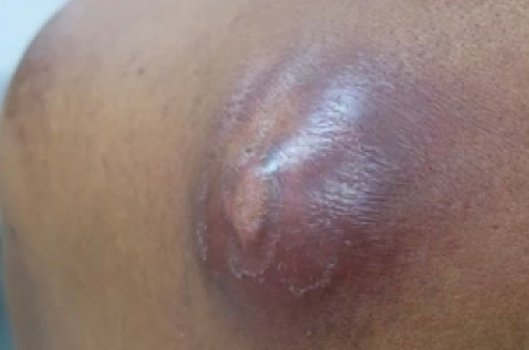
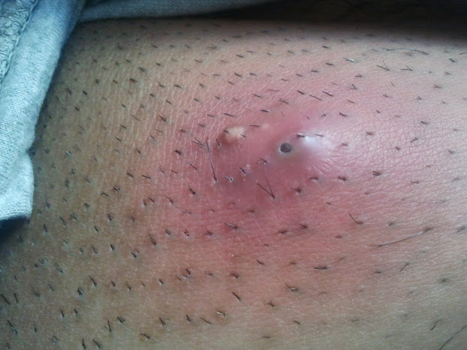
Abscesses
An abscess is a bacterial infection.
Abscesses are painful collections of pus that develop under the skin.
They are most often caused when bacteria collects under the skin after a missed shot.
Initial symptoms include redness/grey/ashy discoloration, swelling, and tenderness.
Photo: Amrith Ra
Notes:
Trainer notes:
Injection drug use is not the only thing that can cause a skin abscess. However, some of the more common causes of abscesses when injecting drugs may include:
Missed hits or shots
Injecting a solution with a lot of particles (ex: pills)
Not cleaning the skin before injecting
Used or un-sterile injecting equipment
Cocaine/Crack injection
Weakened immune system

Slide 15
Basic Abscess Care
For participants presenting with a possible abscess, share the following suggestions and, if possible, provide wound care supplies:
To reduce the likelihood or severity of abscesses, directly after missing a shot, raise the limb to prevent swelling, and ice the area.
Once an abscess has formed (usually 1-3 days following a missed shot or other bacteria exposure), apply heat to the area for about 20 minutes, 4 times per day.
Except for when you are applying heat, keep abscess dry and covered.
Use the driest, most sterile materials—preferably gauze and medical tape—to which you have access.
Change the bandages if they get wet.
If able, wear gloves and/or wash hands before removing or replacing dressings and bandages.
Over-the-counter pain relievers may help reduce the swelling and discomfort caused by an abscess.
Notes:
Trainer notes:
Heat for unopened abscesses can be in the form of handwarmers, heating pads, or warm water baths/soaks. It is not uncommon for people to add Epsom salts in the water as a holistic aid for faster healing. Some programs distribute bags of Epsom salts for their participants.

Slide 16
Basic Abscess Care
Elevate the abscess above the heart as often as possible to decrease swelling.
To avoid further wound trauma, avoid any injections on or near the abscess or on the same limb as the abscess.
Some abscesses will go away without opening up.
If the abscess begins to open and drain, wash the wound out with soap and warm water.
Keep the area clean and dry. Wash with soap and water once a day, if possible.
Continue to use warm compresses for as long as it’s draining but discontinue soaking in hot water/baths.
Apply dressing, cover with a bandage, and change it daily, if possible.
Continue to monitor abscess for signs of worsening infection or failure to improve.
Notes:
Trainer notes:
Trying to treat the abscess upon initial presentation may circumvent the abscess from opening up and draining. Other things that could be recommended to participants may be more holistic, such as trying to boost the immune system through diet and rest. These will not always be feasible for individuals but could help in the healing process.
Because an abscess can progress to a more complicated infection and because there are other conditions that may look like an abscess upon initial presentation, monitoring the abscess is important.
Signs of worsening infection may include increased swelling of the wound or around the wound, changes to the skin color of the wound, wound is hot to the touch, fever, nausea, vomiting, dizziness.
To better monitor abscess size some people will draw a circle around the abscess with a sharpie. Another recommendation is to take a photo everyday next to an object (such as a lighter) and try to get a similar looking photo each time.

Slide 17
Responding to a Hit Nerve
While there is no definitive guidance around how to respond to a hit nerve, the following recommendations have been gathered from community members:
Pain:
Pain has been described as a mild feeling of pins and needles to intense burning or feeling an electric shock moving through the limb.
Reducing the pain of a hit nerve:
Icing the area immediately after hitting a nerve can help.
Over-the-counter pain relievers and heat in the days following may help.
Rest the area—avoid injecting into that limb or area while the body heals.
Pain/pins and needles sensation typically improve within a few days or weeks.
Notes:
Trainer notes:
Nerves and nerve pain can still be a mystery to the medical community. There are not set standards for how to respond to and how to treat accidental hit nerves. However, we do know that nerve damage may result in:
Pain/prolonged pain
Localized numbness
Motor control issues

Slide 18
Responding to a Hit Artery
Because punctured arteries may present an immediate danger from blood loss as well as possible unseen complications, providers may want to educate program participants on how to respond.
Apply pressure, elevate limb above the head, if possible, for at least 10 minutes.
If weak from blood loss, try to get help applying pressure from a friend or other bystander.
Apply a tourniquet 2-3 inches above the wound and seek emergency medical services, if possible.
Even if the bleeding stops on its own, seeking medical services as soon as possible may decrease the risk of further complications.
Notes:
Trainer notes:
Veins carry unoxygenated blood towards the heart while arteries carry oxygenated blood to the rest of the body. Arterial blood is under high pressure and thus when punctured, tends to spurt rather than flow. If hitting an artery with a syringe it is bright red, foamy and gushes into syringe. Bleeding may be difficult to stop if punctured.
While information is limited about accidental arterial injection with unregulated drugs, it is possible that further damage from arterial injection may result in inflammation of the arterial lining, tissue damage and tissue necrosis, limb amputation, and thrombosis, among other risks.

Slide 19
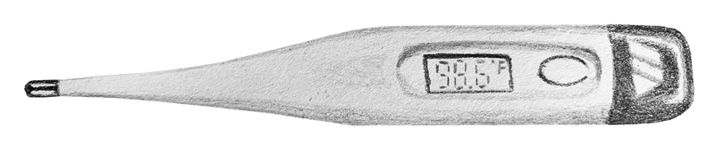
Cotton Fever
Because Cotton Fever may initially present as a virus, other infections, or withdrawal, it may be something to advise participants to look out for.
Cotton fever is a short acting bacterial infection believed to be caused by bacteria that can live in used cotton filters.
Cotton fever is not usually life-threatening.
It may be characterized by a rapid onset of symptoms.
Common symptoms may include chills, fever, shaking, hot flashes, nausea, vomiting, abdominal pain, back pain and headache.
If symptoms last longer than 6 hours, consider visiting the ER as it might be a more serious condition.
Image: www.zerostigma.art
Notes:
Trainer Notes:
Explain “cotton shot” to audience
Onset of CF may feel like withdrawal or a virus but generally comes on within a half hour after injecting. Symptoms can be incredibly uncomfortable and painful. In addition, the rapid onset may be unnerving for some. Generally, cotton fever is short-lived, with people seeming to feel better within 6 hours, although some report cotton fever having lasted over 24 hours.
While there is not a great deal of medical literature available about this condition, there is knowledge shared between service providers and their program participants as well as among community members. Some tips around mitigating Cotton Fever include taking Over-the-counter pain relievers to help relieve pain and break the fever, hot baths for aching backs (be sure that you can get in and out of bath safely), and drinking a lot of water.

Slide 20
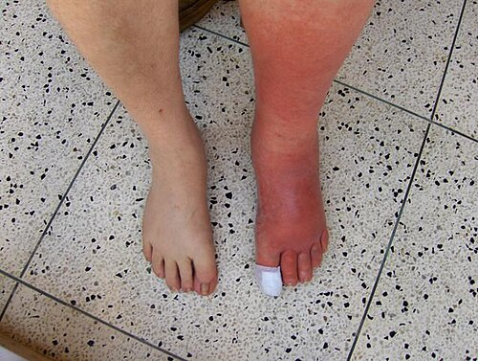
Cellulitis
A bacterial infection of the skin and subcutaneous tissue.
May occur when bacteria enters the skin.
Appears as a swollen, discolored area of the skin that feels hot and tender.
Can give the skin a pitted, orange peel-like or blistered texture.
Cellulitis is treated with antibiotics and needs medical attention.
Photo: Creative Commons
Notes:
Trainer Notes:
Cellulitis is often successfully treated with a course of antibiotics. Untreated, the infection can spread into the bloodstream and cause sepsis, which can be life-threatening.

Slide 21
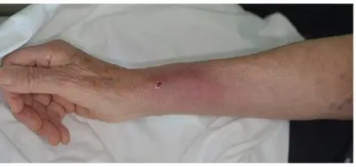
Staph Infection
For program participants presenting with painful bumps under the skin, cuts that look swollen and filled with pus, sores that look like spider bites, or fluid filled blisters it may be helpful share the following information about Staph and MRSA. Distribute hand sanitizer, soap, and adhesive bandages if possible.
Staph infections are caused by Staphylococcus bacteria. This bacteria is commonly found on our skin and most of the time does not cause harm. However, it can enter the body through a break in the skin and cause an infection. Staph infections may be dangerous if left untreated.
Staph infections can look like pimples, boils or other skin conditions.
Staph infections can cause sepsis, pneumonia, endocarditis, and bone infections (osteomyelitis).
People who inject drugs, have chronic conditions, have weakened immune systems, who are hospitalized or recovering from surgery may be at greater risk for infection.
Most staph infections can be treated with antibiotics.
Photo: Skin Infections Caused by Staphylococcus aureus | HTML | Acta Dermato-Venereologica

Slide 22
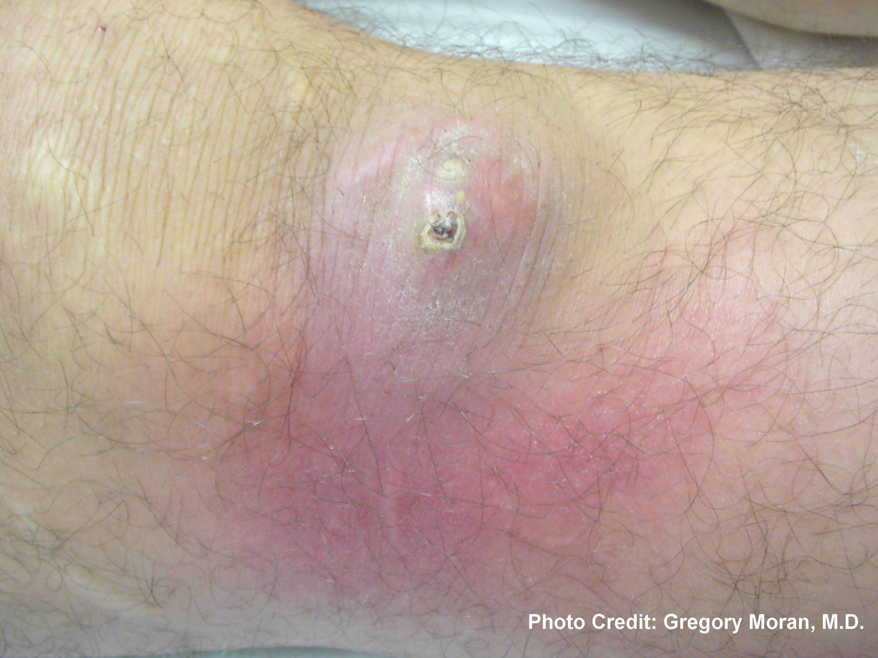
MRSA
MRSA (methicillin-resistant Staphylococcus aureus) is a form of staph bacteria that is resistant to many common antibiotics and can be difficult to treat.
MRSA bacteria can be spread from skin-to-skin contact or sharing towels, razors, syringes, or anything else someone has touched.
Initial presentation of MRSA infection may look like a spider bite or abscess.
Because a MRSA infection may be difficult to identify, it is important to seek medical attention if the wound is not improving on its own or getting worse after a few days.
Untreated MRSA infection can lead to sepsis or death.
Notes:
Trainer notes:
A person may be a MRSA “carrier,” which means they carry the bacteria without having an infection. They can still spread the bacteria to others.
MRSA infections are very serious and may initially present as other health issues.
A MRSA infection may present with:
Discolored skin and swelling of the area
Warm to the touch
Oozing pus or other drainage
Painful
Fever

Slide 23
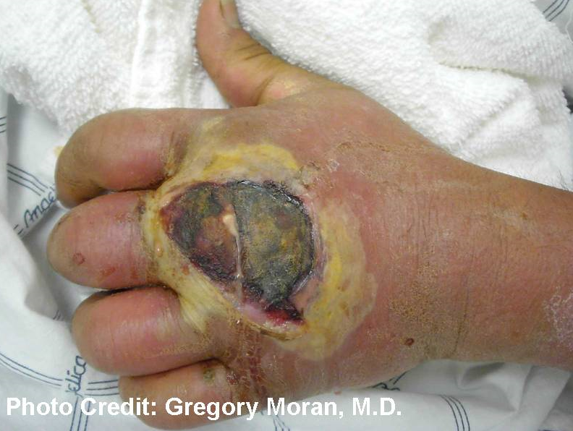
MRSA Infection
MRSA infections are serious conditions requiring medical attention.
Avoid touching, squeezing or poking sores.
Cover sores with a bandage if possible.
Follow directions when taking antibiotics and finish taking all antibiotics, even if the infection seems to have improved.
More advanced infections may require having the wound drained and being placed on intravenous (I.V.) antibiotics, which typically involves a hospital stay.
Active MRSA infections are contagious!
Wash hands frequently, especially after contact with the infected area. Use alcohol-based sanitizer if soap and water are not available.
Bathe daily, if possible, to help reduce number of bacteria on the skin.
Change clothes daily and wash them before wearing if possible.
Keep skin moisturized with lotion to avoid cracking.
Wash any cuts or scrapes with soap and water and cover with adhesive bandage.
Preventing other people and pets from coming into contact with the infection is the best way to avoid spreading it.
Notes:
Trainer notes:
The CDC states that although MRSA is one of the more well known staph infections, any staph infection can be dangerous, even if it not resistant to antibiotics

Slide 24

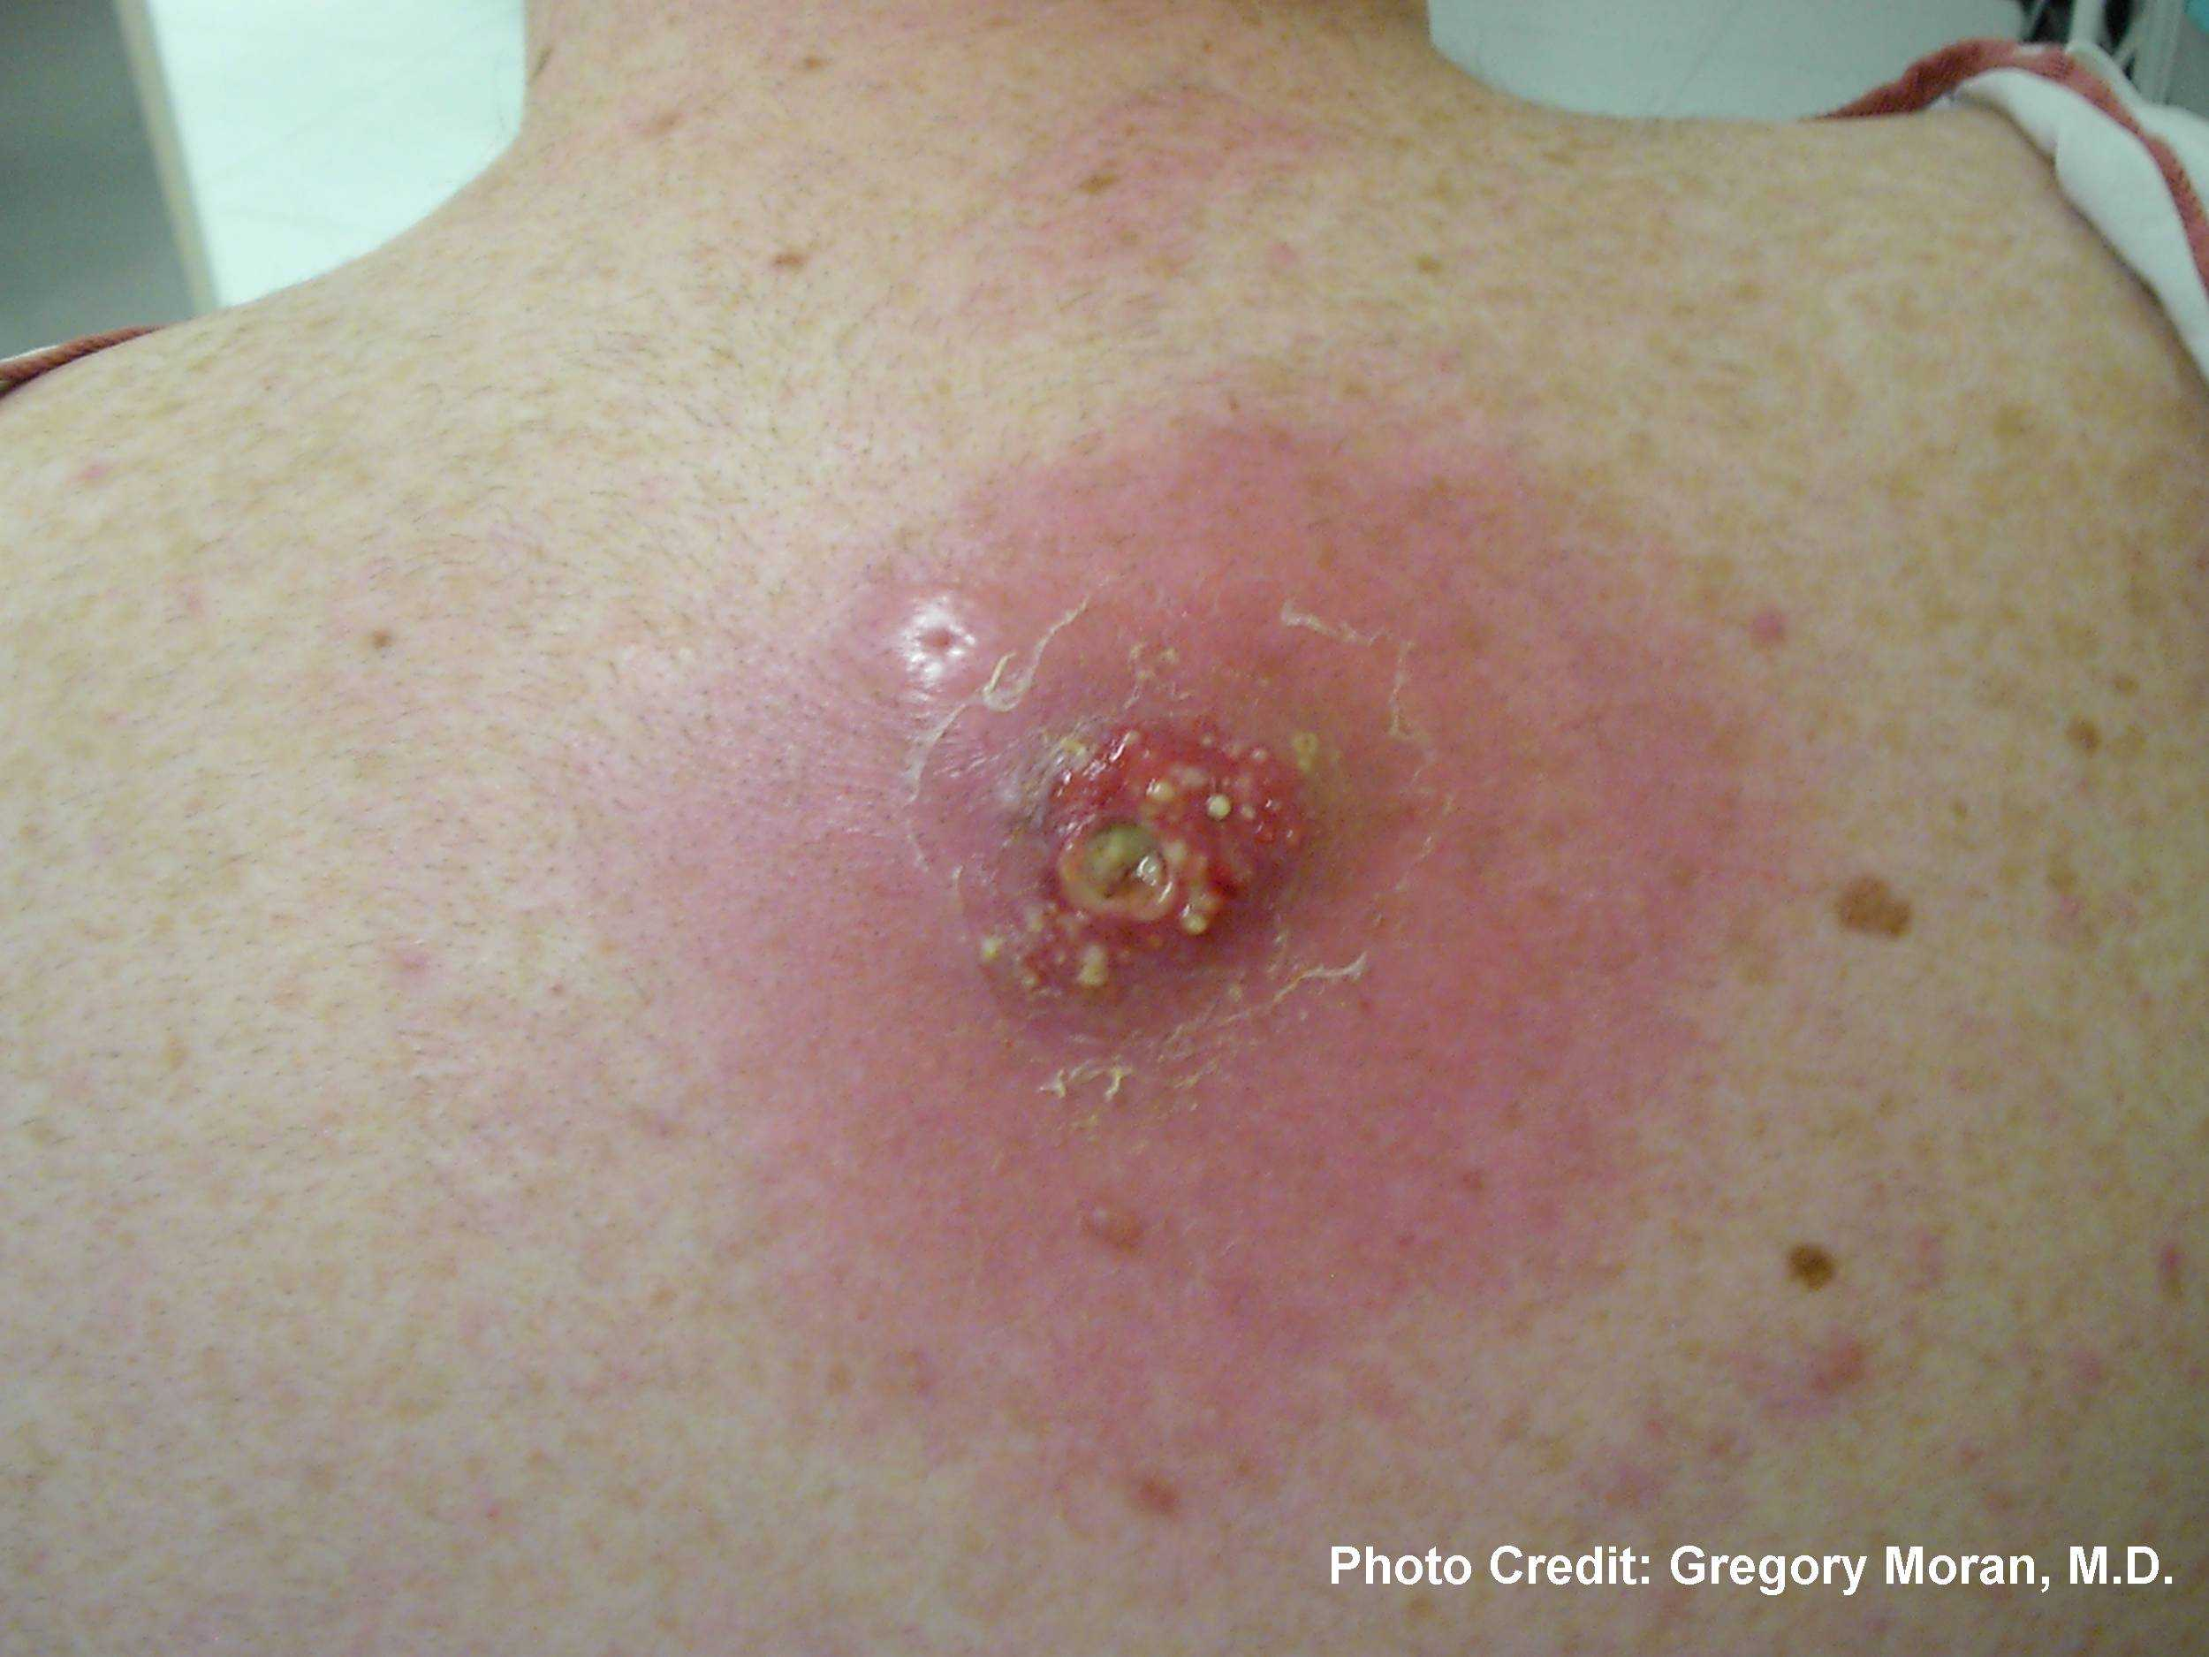
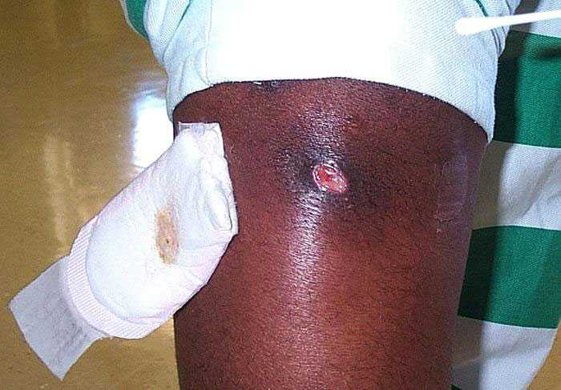
MRSA, Additional Images
Photos:MRSA Photos | Community | MRSA | CDC

Slide 25
Infective Endocarditis
Infective Endocarditis is an infection of the heart lining that is caused by infectious build-up around the heart valves that weakens the heart. Because of the damage that can be caused by endocarditis and the intensive treatment process, early detection can be lifesaving. Service providers should be familiar with early signs and risks of infection.
Symptoms may include fever, chills, joint pain, confusion, shortness of breath, swelling of feet and legs, chest pains, blood in urine, stomach pain, pain or numbness in an arm or leg.
Heart murmurs may develop or pre-existing ones may change.
Treatment may be complex and requires IV antibiotics; sometimes surgical interventions are necessary.
Even successfully treated endocarditis can lead to chronic health issues.
If untreated, infective endocarditis is fatal.
Notes:
Trainer notes:
Infective endocarditis may progress very rapidly.
Treatment may be complex, involving IV antibiotics and that can often mean weeks in a hospital bed. It may also require surgical intervention.
Hospitalizations for Endocarditis and Associated Health Care Costs Among Persons with Diagnosed Drug Dependence — North Carolina, 2010–2015 | MMWR (cdc.gov)

Slide 26
Sepsis
Sepsis is also known as blood poisoning. It is caused by a systemic (throughout the body) infection, usually caused by bacteria. Sepsis is a life-threatening medical emergency and can progress rapidly.
Anyone displaying signs of sepsis should dial 911 or go to the Emergency Department as soon as possible. They may include:
Thin dark line may be visible on skin Line moves up the arm, for example Fever, shivering, feeling cold to the touch | Extreme pain or discomfort High heart rate or weak pulse Shortness of breath Clammy or sweaty skin Confusion or disorientation
Notes:
Trainer Notes:
According to the CDC, sepsis is the body’s extreme response to an infection. It occurs when a pre-existing infection triggers a chain reaction throughout the body. Infections that lead to sepsis most often start in the GI tract, lungs, skin, or urinary tract.
Rapid treatment is necessary and sepsis may lead to tissue damage, organ failure and death.
Treatment often includes: hospitalization, antibiotics, maintaining blood flow to organs (perfusion) sometimes surgery may be required to remove damaged tissue.

Slide 27
Impact of Xylazine on People Who Use Drugs

Slide 28
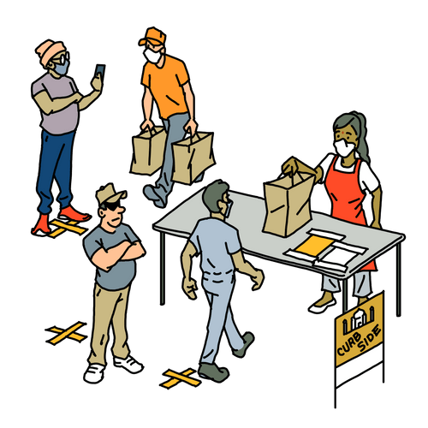
How are you seeing xylazine show up in your community?
Image: www.zerostigma.art
Notes:
Trainer notes:
This is another opportunity to engage with your audience by asking them what they are seeing among their program participants and within their communities. Audience members may bring up a variety of answers that could include:
Seeing unusual wounds that are taking months (or longer) to heal
People not “waking” from overdose after administering naloxone/people reportedly using more doses of naloxone because of this
Atypical “nods” in which a person may remain in the same position and be unrousable, essentially in deep sedation
People leaving inpatient treatment facilities because such facilities are not prepared to handle xylazine wounds
People discontinuing MOUD because it does not assist in xylazine withdrawal
More fear about the unregulated drug supply
Try to engage the audience with additional questions if possible. Example questions could be:
How are your program participants managing their wounds?
What strategies are participants sharing about how they are taking care of one another right now?
If participants have found a medical facility/provider that could medically manage xylazine withdrawal, where did they go and how were they treated by staff?

Slide 29
What to Know:
Service providers should understand the various harms that may be caused by xylazine.
Providers can help educate their program participants on basic first aid for xylazine-associated wounds as well as distribute wound care supplies if possible.
When distributing naloxone or discussing overdose response, service providers should be able to communicate the effects of a xylazine-involved opioid overdose as well as provide resources around rescue breathing.
Providers should offer risk mitigation strategies around the harms that may be caused by extreme sedation.
Providers can better understand how xylazine withdrawal may impact treatment for MOUD and help educate program participants as well as other service providers and medical professionals.

Slide 30
About Xylazine
Historically, xylazine has been used as a veterinary sedative and is not approved for human medicine.
In the early 2000s, xylazine entered the heroin and cocaine supply in Puerto Rico.
It appeared around 2006 in the Philadelphia drug supply with a notable increase in the mid to late 2010s.
Detected spread of xylazine throughout other states began around 2019.
Notes:
Trainer notes:
This is a good time to engage audience and ask them why xylazine might be used as a cutting agent.
It is likely that there is regional variation in how xylazine is processed and sold. In some street samples it is found as a primary constituent and in others it is in trace quantities.
Researchers have suggested that it may be used as a bulking agent in order to reduce the amount of opioid in cut and to create less severe respiratory depression. Researchers also state that people who use both fentanyl and xylazine note that xylazine increases the effect and duration of fentanyl and helps delay the withdrawal symptoms.

Slide 31
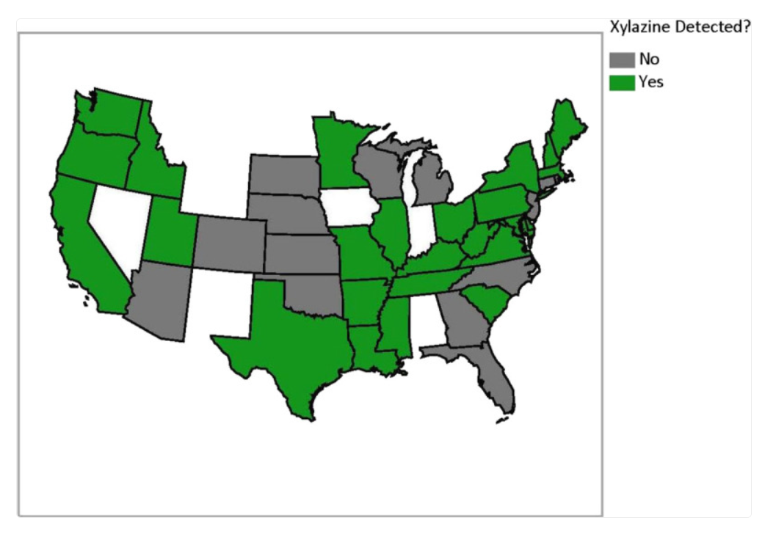
Spread of Xylazine, 2021 – 2022
Image: Holt AC, Schwope DM, Le K, Schrecker JP, Heltsley R. Widespread Distribution of Xylazine Detected Throughout the United States in Healthcare Patient Samples. J Addict Med. 2023 Jul-Aug 01;17(4):468-470. doi: 10.1097/ADM.0000000000001132. Epub 2023 Jan 6. PMID: 37579111; PMCID: PMC10417214.
Notes:
Trainer notes:
From April 2021 to March 2022, Xylazine was identified in 413 of 59,498 samples collected by patients from various healthcare settings in states where xylazine testing was ordered. As this map is only based on data collected from healthcare settings that order xylazine testing, it does not capture the full spread of xylazine. Rather it is an example of how rapidly the unregulated drug supply changes. Because we don’t have a full picture of how these supply trends evolve, it is important to pay attention to what is happening at a local level as well as a national level and to talk to your program participants about their experiences and how they can stay as safe as possible.

Slide 32
Potential Impacts of Xylazine Use
While we are still learning about long-term effects of xylazine use, it can cause:
Sedation
Difficulty breathing
Dangerously low blood pressure
Slowed heart rate
Skin and soft tissue wounds
Severe withdrawal symptoms
Notes:
Trainer notes:
It is unclear what, if any, long term impact may be caused by xylazine use in humans or how much xylazine it takes to cause dangerous side effects.

Slide 33
Xylazine-Related Wounds
May appear in areas other than at or near the injection site.
Initial presentation varies by person but may appear in clusters that resemble blisters or burns.
May be more painful than expected and localized pain may present before wound.
Wounds may develop rapidly and can “tunnel” below the surface to surrounding tissue, muscles, and tendons.
Early treatment using wet wound care techniques can reduce advancement of wound.
Wounds may require long term care including debridement, regular cleaning, and changing of dressing.
Monitor closely for signs of infection.
Notes:
Trainer Notes:
Xylazine-related wounds may be slow to heal and can take months to over a year to heal. Treating early may help decrease the risk of a prolonged wound.

Slide 34
Medical Care May Be Necessary
Infected wounds may require more advanced medical care. Signs of infection may include:
Painful or increased pain/too painful to move area
Hot to the touch
An increased change in color to the area outside of the wound (such as red or grey, depending on skin tone)
Swelling
Fever/chills/fatigue
Nausea/vomiting
Increased drainage/wound fills with pus
Wound emits odor that may smell like rotten eggs or meat

Slide 35
Graphic Images Ahead
Notes:
Trainer Notes:
Use this slide to give let your audience know that the next few slides contain graphic images of xylazine-related wounds

Slide 36
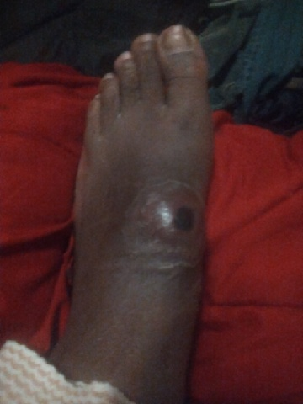
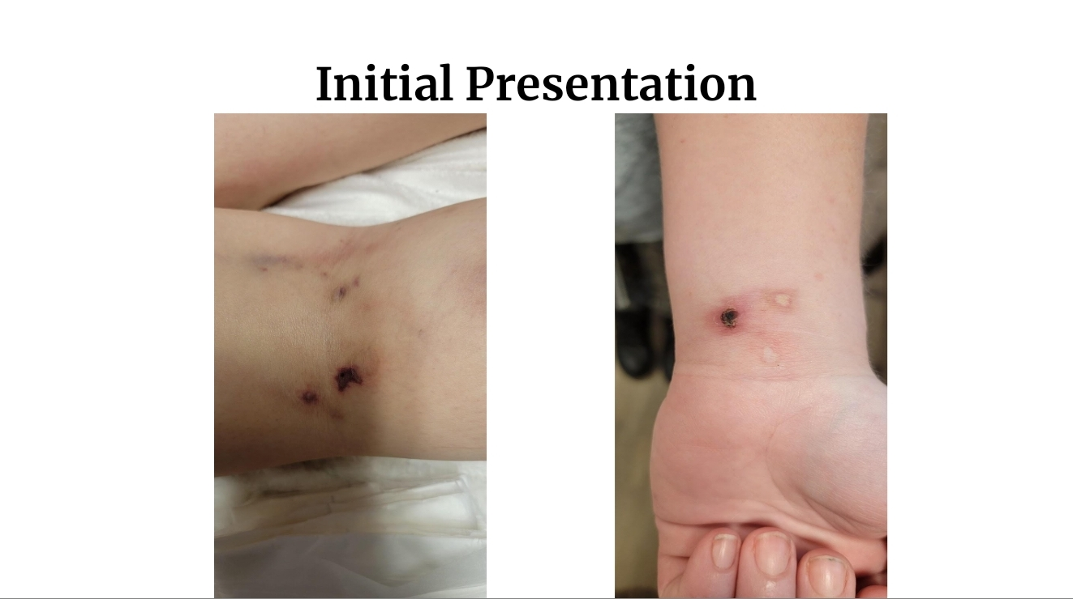
Photos Courtesy of Jason Beinert
Notes:
Trainer notes:
Several examples of early presentation of wounds

Slide 37
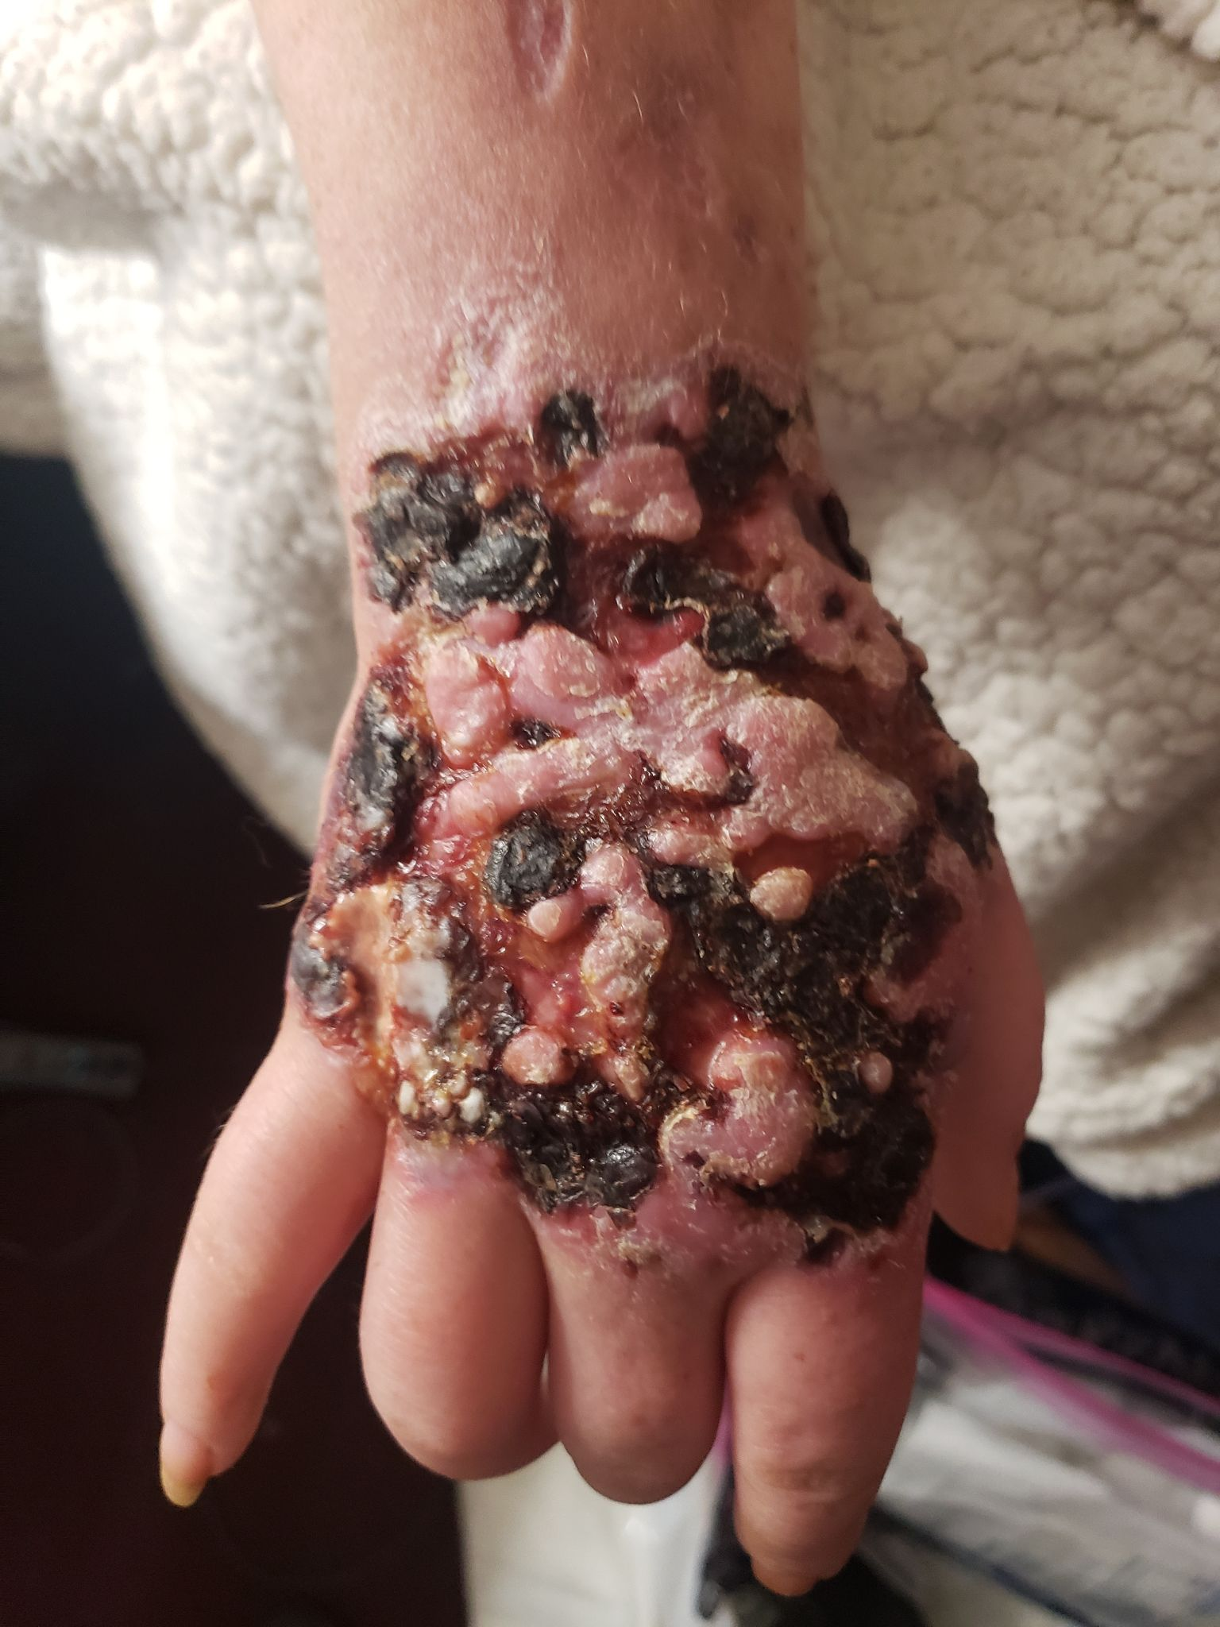
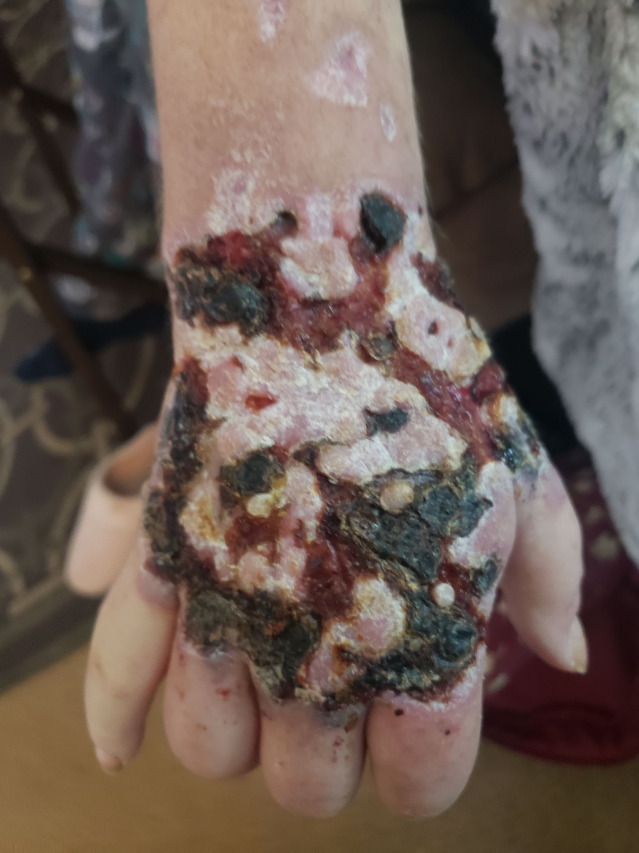
1
2
Photos Courtesy of Jason Beinert
Notes:
Trainer notes:
Duration of healing process almost 1 year for this patient.
Healthy healing. Area around scabs are pink/red.
When looking at wounds, purple edges indicate skin that is necrotic. These color indicators of tissue and skin health will be similar colors regardless of a person’s skin tone.

Slide 38
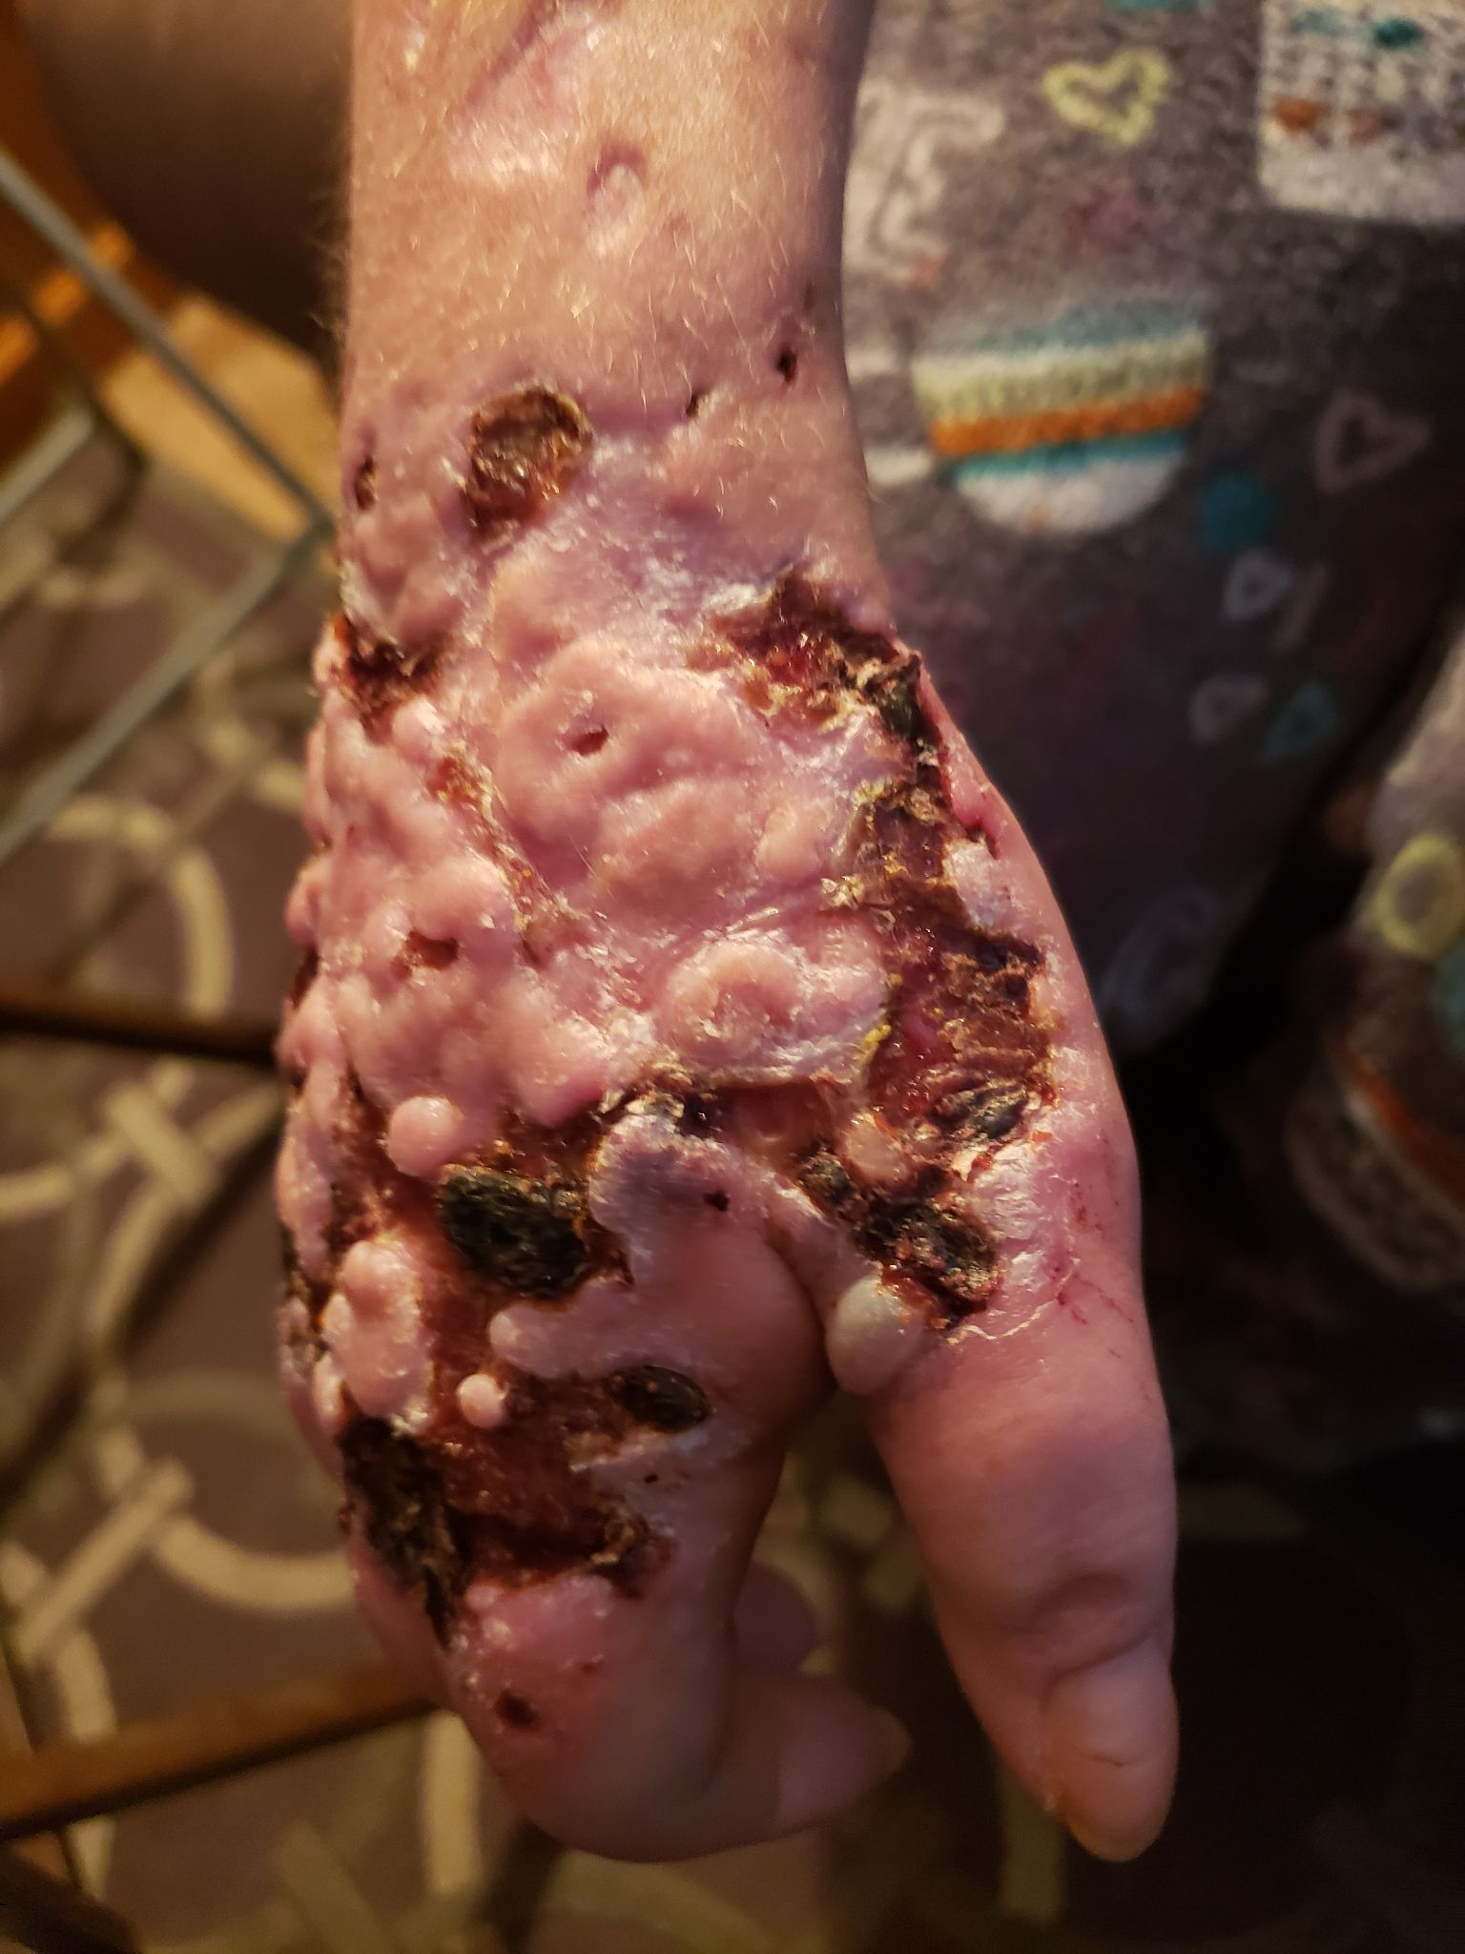
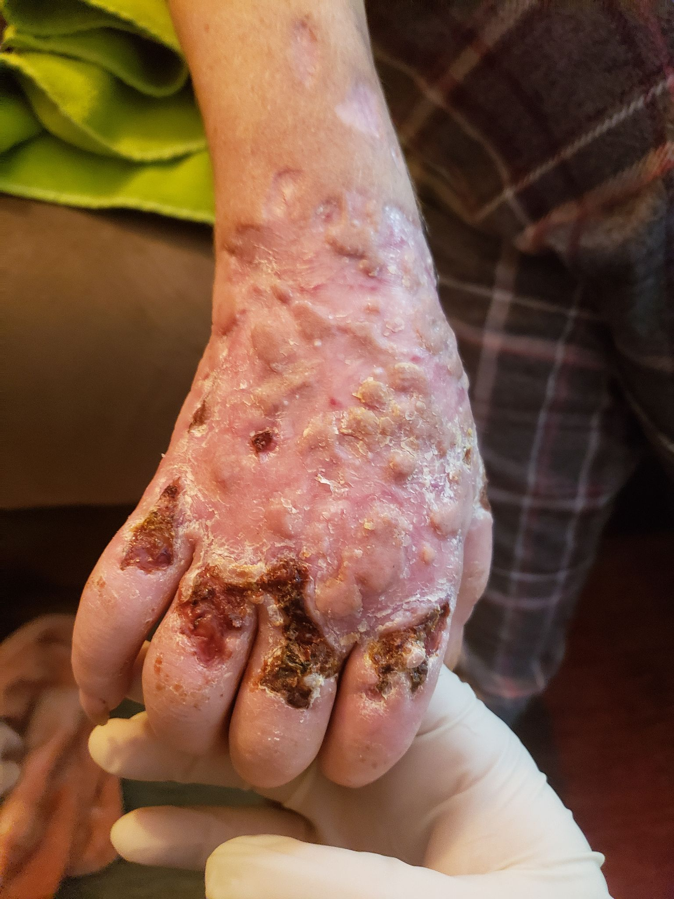
3
4
Photos Courtesy of Jason Beinert

Slide 39
Xylazine Related Wounds and Antibiotics
In the absence of clear symptoms of an infection, a xylazine-related wound does not necessarily require antibiotics. Service providers can discuss antibiotic use and safety with program participants.
Xylazine-related wounds may harbor bacteria from the skin, but this does not mean the wound is infected.
Notes:
Trainer Notes:
This is a good time to discuss antibiotics (ABs). Without an infection, antibiotics are best avoided. If people do have wound infections for which they need antibiotics, they should try to be diligent in taking the entire course of medication, even if the infections improve or people begin feeling better. Taking the full course of ABs will help keep the infection from coming back as well as help reduce AB resistant bacteria.
If using ABs that are not prescribed to you, be aware, not all ABs work in the same way or for all parts of the body andtypes of bacteria.

Slide 40
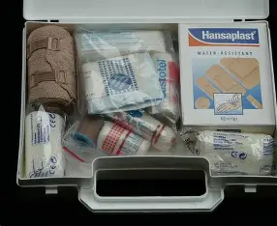
Self-Treating Xylazine-Related Wounds
Given what we know right now, the recommendations to care for xylazine-related wounds are similar to recommendations for caring for other skin and soft-tissue infections using wet wound care methods.
Photo: Public Domain
Notes:
Trainer notes:
Basic advice is similar to other SSTIs which includes trying to keep the areas of the wound as clean as possible, trying to be as hygienic as possible when changing bandages and dressing, avoid picking at wounds, if possible avoid injecting in or around wound area or same limb.

Slide 41
Basics of Wet Wound Care
Notes:
This is approximately halfway through the presentation and may be a good time for a break

Slide 42
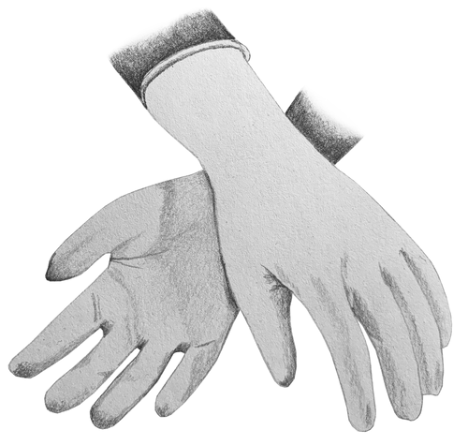
Basics of Wet Wound Care:
1
Depending on your role and the capacity of your program, it may be helpful to perform a bandage change with a participant, so they are clear on process and supplies. Providers can help participants understand the importance of hygiene in wound care and help problem solve how to create a hygienic environment for bandage changes.
Wash your hands with soap and water, use hand sanitizer or wear new disposable gloves before dressing bandages.
Try to create a clean workspace by either wiping the area down with a surface cleaner or use some sort of barrier such as cling wrap, foil, or newspaper.
Lay your supplies out before you start changing bandages.
Gently wash the wound and surrounding area with soap and water,
saline, or water.
Image: www.zerostigma.art
Notes:
Trainer notes:
You may need to discuss the basics of handwashing when discussing wound care. This includes using fresh running water and soap, lathering vigorously being sure to soap all around hands, base of wrists and underneath fingernails for at least 20 seconds. Rinsing and drying with a clean towel or air dry.
Recognizing that not everyone is going to have access to fresh running water, hand washing is not always going to feasible. If unable to wash hands and it is available, using hand sanitizer or alcohol prep pads will be helpful as well.

Slide 43
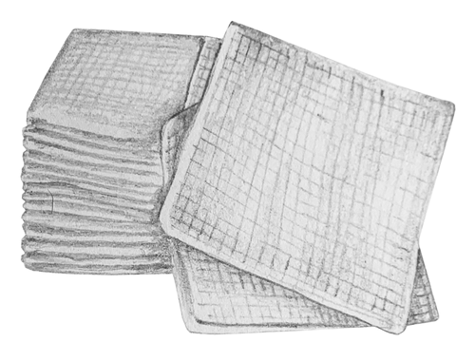
Basics of Wet Wound Care:
2
Apply an ointment such as A&D or petroleum jelly on the healthy surrounding skin.
For the dressing, apply the ointment onto non-stick gauze and place directly onto the wound.
For the bandage, wrap with roll gauze and tape.
For added protection you may want to lightly wrap the gauze with athletic wrap.
Image: www.zerostigma.art

Slide 44
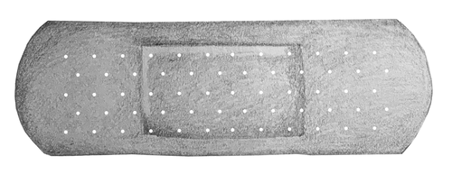
Basics of Wet Wound Care:
3
If able, change your bandage daily
or more often if the bandage soaks
through.
Not everyone will have access to all of these supplies or as much as they need to change their bandages regularly.
Try suggesting other options a person may have access to, such as menstrual pads, clean cotton t-shirts, socks, etc.
Keep the bandages as clean as possible.
Dispose of gloves after changing bandages.
Image: www.zerostigma.art

Slide 45
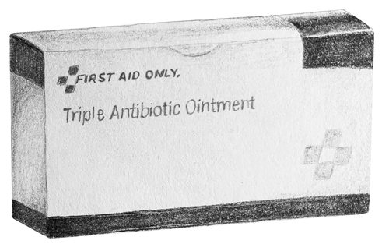
Basics of Wet Wound Care:
4
Keep the wounds as clean as possible, keep them covered, and change wound dressing daily using moist/wet wound care technique.
Store wound care supplies in the cleanest, driest place possible.
Seek medical care if wounds get larger, emit pus or become necrotic.
Image: www.zerostigma.art

Slide 46
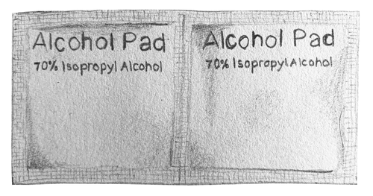
Basics of Wet Wound Care:
5
Educate people not to use
peroxide, alcohol, or bleach to
clean their wounds.
As wounds heal, encourage people to massage their scars to break down the scar tissue.
Encourage range of motion exercises for healed areas with thick scar tissue.
What are other pointers you can share with people about wound care/bandage changes that they may not know?
Image: www.zerostigma.art

Slide 47
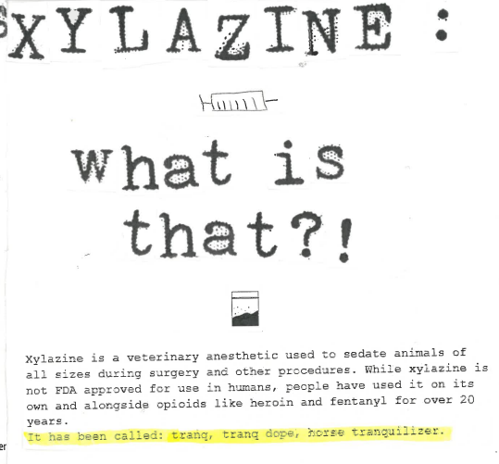
Other Strategies for Reducing Risks Related to Xylazine
Notes:
Trainer notes:
The following are tips suggested by people who use drugs and the people that serve them. Some may be helpful to share with your program participants.

Slide 48
Program participants that are not injecting drugs may still be at risk for xylazine related wounds.
It seems many people are reporting that xylazine-related wounds are primarily associated with injection drug use.
Without more research, no route of administration can be described as “safer.”
Notes:
Trainer Notes:
While many are reporting xylazine-related wounds being associated with injection this does not mean that it is not causing wounds and other issues through other routes of administration.
This is a good time to talk to your audience about what they are observing or hearing from program participants around xylazine-related wounds and routes of administration.

Slide 49
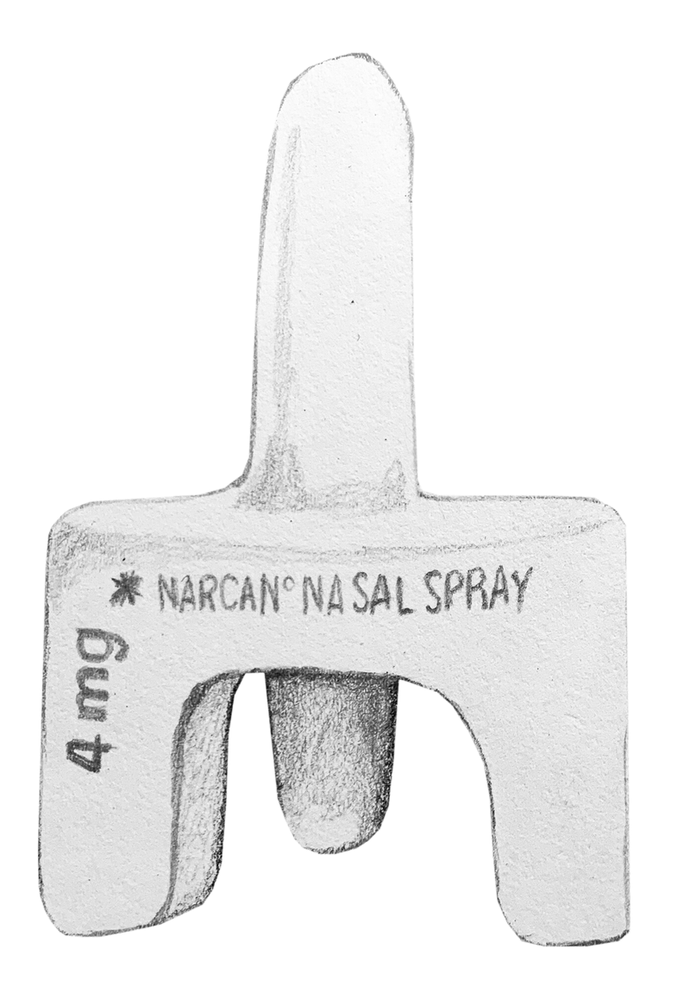
Naloxone and Xylazine-Involved Overdose
Naloxone will still reverse opioid overdoses,
even if xylazine is involved. Continue to
encourage people to carry and use naloxone.
Xylazine sedation—and depressed
breathing—may still occur once the opioid
overdose is reversed.
Encourage people to learn and use rescue breathing to supplement naloxone administration and other opioid overdose response strategies.
Image: www.zerostigma.art
Notes:
Trainer Notes:
According to CDC, xylazine-involved overdose symptoms can include the following:
Decreased alertness to full sedation
Slowed breathing
Slow heart rate
Low blood pressure
High blood sugar
Pinpoint pupils

Slide 50
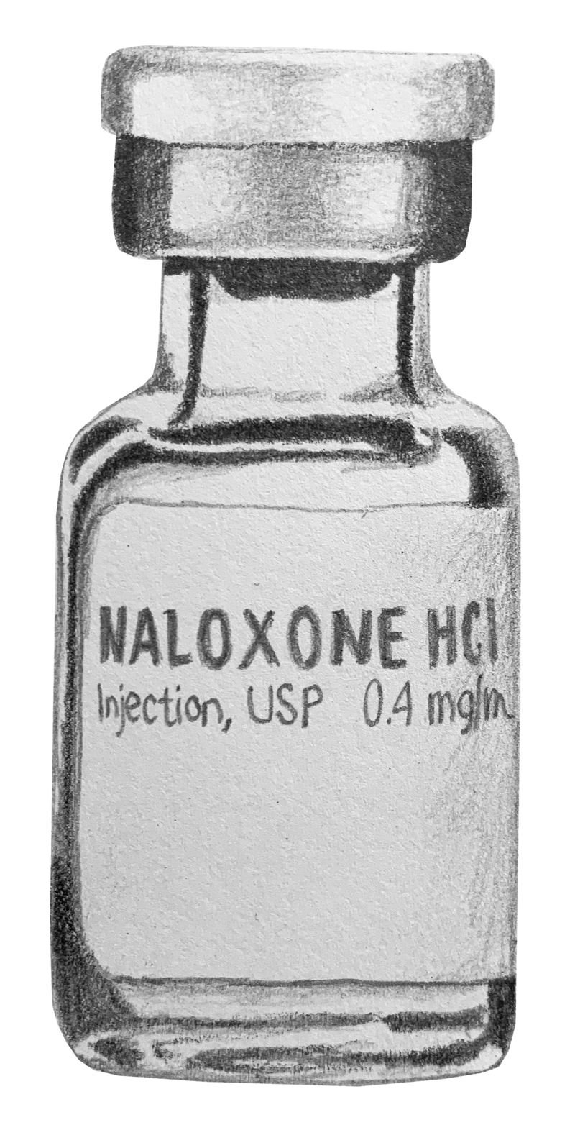
After Using Naloxone…
After naloxone is administered, a person’s usual
coloring may return to their face and fingers and they
may take slow, shallow breaths without returning to
consciousness.
If a person resumes breathing but is still not waking to consciousness, you do not need to administer more
naloxone.
For a person who is breathing but not awake, count breath rate per minute to determine if they are in need of supplemental oxygen. Rescue breathing or supplemental oxygen may be necessary if respiration is under 8 to 10 breaths per minute.
Service providers can teach program participants how to count breaths per minute (BPM) and how to provide rescue breathing.
Image: www.zerostigma.art
Notes:
Trainer notes:
To quickly calculate breaths per minute, count how many breaths a person takes within a 15 seconds and multiplying by 4 to get an average BPM rate.
May not always be easy in an emergency situation but is an important tool in opioid overdose response.

Slide 51
Managing Sedative Effects
Xylazine can cause prolonged periods of sedation, during which people remain immobile.
Complications from immobility may include:
Muscle weakness
Blood clots (Deep vein thrombosis)
Decreased range of motion in joints
Respiratory complications
Pressure ulcers
Heat burns, freezing, or other environmental harm caused by immobility outdoors
Increased vulnerability to physical assaults and robbery

Slide 52
Managing Sedative Effects
Due to long periods of sedation, a person may be at greater risk of developing musculoskeletal, nerve and pressure injuries as well as deep vein thrombosis (deep clots).
Try to lay people on flat and smooth surfaces.
Try to move people every two hours.
  If they are laying down, move them from side to side.
  If they are sitting up, be aware of the position of their limbs to ensure their circulation is not being cut off; shift as needed every few hours.
Try to use padding, such as pillows or clothing under body parts that are in contact with hard surfaces.
Advise people to use with other people they feel safe with, as sedation may put people at greater risk of physical assault, robbery and other injury.
In extreme heat or cold, advise people to use in a place where they can be protected from the elements,
Notes:
Trainers notes:
According to the CDC, Musculoskeletal injuries are soft tissue injuries that may be caused by sudden or sustained exposure to repetitive motion and awkward positions. To help avoid these injuries, researchers recommend following protocols used to prevent pressure injuries (pressure ulcers/bedsores).
Care should be taken not to damage skin when moving people, especially if they have known xyalzine-associated wounds.
In addition to physiological harms associated with prolonged sedation, people are more vulnerable to their environmental conditions.
Reducing the harms of xylazine: clinical approaches, research deficits, and public health context - PMC

Slide 53
Xylazine Withdrawal
People that have developed dependence on xylazine may experience severe withdrawal.
Symptoms are not always well-defined and may include severe anxiety and agitation as well as elevated blood pressure and heart rate.
Xylazine withdrawal may begin before, after, or be concurrent with opioid withdrawal.
Timeline for which xylazine withdrawal occurs is unknown but it has been reported as starting within 6-12 hours after discontinued use.
People taking medication for opioid use disorder may opt to discontinue treatment, as MOUD does not ease symptoms of xylazine withdrawal.
Medical facilities are learning how to medically manage xylazine withdrawal, with medical professionals collaborating in real-time to identify best practices for treatment.
Notes:
Trainer notes:
While new practices for treating xylazine withdrawal are emerging, some things to note include: xylazine withdrawal may be hard to pinpoint when concurrent with opioid withdrawal. Withdrawal from other substances, such as benzos or alcohol may also affect the presentation and timeline of xylazine withdrawal.
Guidance from Penn Medicine and Center for Addiction Medicine and Policy state that “A hallmark of xylazine withdrawal is that additional doses of full agonist opioids do not improve symptoms.” Full opioid agonists (that have no xylazine adulteration) include but are not limited to methadone, morphine, heroin, and fentanyl.
CAMP-Xylazine-Best-Practices-1.pdf

Slide 54
Medical
Self-Advocacy
Notes:
Trainer notes:
This information is for people who are reluctant or resistant to engage in medical systems for any reason, not just for drug-related issues. It is also for people who do want to access medical systems but find that the systems they are able to access may be stigmatizing or may not be knowledgeable about health issues faced by people who use drugs.

Slide 55
Why is it important that people who use drugs (and the people that support them) know how to advocate for themselves (and their participants) in medical settings?
Notes:
Trainer notes:
As a service provider, vetting and building relationships with local medical professionals and clinical providers can be extremely helpful! Does your program have capacity to build relationships? Are you located in an area where options are limited for medical providers?
In the absence of knowing where a program participant may receive excellent and stigma-free care, helping program participants feel better prepared for medical visits can be empowering. Even in the presence of excellent and stigma-free care, feeling better prepared for the visit may help ensure a better experience overall.
Sharing tips for better engagement with medical providers may help program participants seek more comprehensive medical care and feel more confident in managing their health.

Slide 56
What to Know:
As service providers it is important to understand the barriers that may keep people from seeking routine medical care.
While we work towards excellent and stigma-free care for all people, we can help empower program participants in the meantime to advocate for themselves in medical settings.
The following slides include suggestions and considerations that participants may find helpful when accessing care.
Notes:
Trainer notes:
Because so many conditions may have similar symptoms or may require intensive treatment, helping to better prepare people for medical appointments can be a step to ready them to seek medical care.

Slide 57

General Guidance When Seeking Medical Care
Service providers can share information about finding
providers, tips on preparing for a medical visit,
navigating the medical visit, and steps to take after an
appointment.
Important to remember:
The relationship between patient and medical provider
should be nonjudgmental and patients should be able
to comfortably talk with their providers about drug use
and other aspects of their lives to the extent that they
want to disclose.
It is NOT the fault of a person who uses drugs if their medical provider is judgmental towards them or makes them feel stigmatized—it is a medical provider’s job to provide care without judgment.
Image: Creative Commons
Notes:
Trainer notes:
Service providers can help reduce internalized stigma in their participants and remind them that the relationship between a patient and medical provider should be non-judgmental. And because that is not a guarantee, helping people advocate for themselves in medical settings may be helpful.

Slide 58
Finding a Provider
Community health fairs may offer opportunities for preventative services, routine examinations, and testing.
It isn’t always possible to choose your provider—some areas have a limited number of doctors or clinics, or covered providers may be limited by your insurance plan. In emergency situations, getting to the ED should be the priority—but it can be helpful to be familiar with how the hospitals or providers in your area treat people who use drugs.
Ask friends, community members, and participants and staff at your organization and partner organizations for recommendations of places to go and places to avoid.
  Even if nobody can recommend a compassionate provider, it helps to know what to expect should you decide to seek care.

Slide 59
Before a Medical Visit
If you’re feeling uncomfortable or nervous about an appointment, ask a trusted friend, family member, or other peer support to go with you as an observer and/or advocate..
If nobody can join you in person at the appointment, you might be able to have them join your appointment by phone.
Some medical facilities have peer support available by request—ask if this is the case when scheduling.
If you are on MOUD and you have an upcoming stay at a hospital, ask staff how they incorporate MOUD into daily care.
If you are anticipating staying overnight or longer at a hospital, make a checklist of what needs to be done at home prior to leaving, or taken care of while you’re away.
Notes:
Trainer notes:
Some medical facilities won’t have good reception for call and others may have rules about using video calls, such as Facetime. People can ask staff ahead of time.

Slide 60

Before a Medical Visit
If nervous about talking to medical staff or worried you’ll forget something, you can make a list of the following information:
  List of symptoms and how long you’ve had them
  Current medications
  Relevant family history
  Questions for the provider
  If receiving take-home medication, your preferred pharmacy
  Any other concerns
If someone is accompanying you on your visit, you can ask them to take notes and advocate for you.
Photo: Billy Golden
Notes:
Trainer notes:
It may be helpful to talk to program participants about having support at their appointments. If they have friends/family joining, they can discuss ahead of time about the type of support they need.
Advise participants that are on MOUD and are expecting to stay in a hospital/medical facility, to find out ahead of time how the facility handles MOUD. Some facilities will transition people on methadone to bupe while in hospital so it will be helpful to know what to expect in terms of MOUD management.

Slide 61
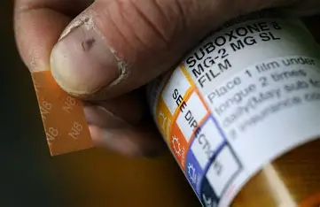
Before a Medical Visit
If you’re on MOUD or any psychiatric
medications, be sure to bring along the
name and contact info for your clinic,
prescriber, and/or psychiatrist. If
admitted to the hospital overnight, this
will make it easier for staff to reach
your providers and minimize
disruptions in your care.
Bring a pen and paper or your phone to take notes for documentation.
Prepare for your visit—you may be in the waiting room and/or with staff for a long time.
Photo: Creative Commons
Notes:
Trainer Notes:
It may be helpful to have a phone charger with you if you anticipate a long visit as well.

Slide 62
During a Medical Visit
You never have to discuss your substance use if you feel uncomfortable or unsafe doing so.
If you feel comfortable disclosing any substance use, you can ask your medical provider questions about any potential interactions with prescribed medications.
Take notes, or if you’ve brought someone else along, ask them to take notes for you.
Sometimes nursing students or medical students will stay in the room for observation. If you feel there are too many people in the room, you can request to just speak with the doctor.
Notes:
Trainer notes:
Remind program participants that if they are bringing somebody along for support, there are certain tests and procedures that their visitors will not be allowed to accompany them to such as x-rays, MRIs etc.

Slide 63

During a Medical Visit
You have a right to informed consent and your provider should explain any procedures, interventions, or treatments to you before they’re performed.
You have the right to agree to treatment or to refuse it.
Photo: Creative Commons
Medical staff will usually ask you to sign a refusal of treatment form if you do refuse treatment.
Refusing care can sometimes result in negative treatment from staff.
Try not to get pulled into a negative exchange, Remember, you have the right to ask for a different provider.
Notes:
Trainer note:
It is going to be the nurse or technician that is going to provide the hands-on care. If someone feels anxious, nervous, or threatened by the nurse or technicians that will be providing their care/treatment/testing, they have the right to request another nurse/tech (although it may not always be possible to accommodate).

Slide 64
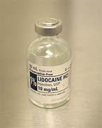
During a Medical Visit
If a provider refuses treatment for any reason (for example, substance use, weight, mental health issues, protected class, medical history), you can request that they document in your chart that you were denied care and for what reason.
Photo: Creative Commons
Ask questions if you don’t understand something. Ask as many times as necessary.
If having a wound lanced and drained, lidocaine or another numbing agent should be offered. If not, you can always request it.
You can request to see your medical chart at any time, for any reason.
This is YOUR appointment—you can end it at any time, for any reason.

Slide 65
After a Medical Visit
If you find you have other questions or need further clarification after the visit, you can contact the provider. Many health systems now use web-based messaging in addition to calls.
You have a right to a second opinion and to seek medical care from a different provider.
If your doctor or any other medical provider acts unethically or does you harm, you can file a complaint about them to your state’s medical board.
Most medical facilities will have a mechanism to file a complaint internally.
If you have Medicaid or Medicare, the Center for Medicaid & Medicare Services has instructions on how to file a complaint about provider behavior, improper treatment, and/or unsafe hospital conditions.
Notes:
Trainer notes:
If discussing getting a second opinion, you may want to encourage participants to check with their insurance providers ahead of time to ensure that any repeated diagnostics performed for the same reason but by a different provider will be covered within that calendar year.

Slide 66

After a Medical Visit
If participants are comfortable doing so, they can let staff at the community-based organizations they frequent know about their experience, whether positive, negative, or neutral. This may help other people who plan on going to that clinic, hospital, or provider in the future know what to expect.
Photo: UW ADAI Empathy Lens Collection
Notes:
Trainer notes:
Also may be important to remind people that are looking for recommendations that their experience may be entirely different than someone else’s.

Slide 67
When Visiting the Emergency Department
According to the Legal Action Center, for drug- or alcohol- related emergencies, the ED should offer:
Screening and diagnosis for substance use disorder
Medications for opioid use disorder
Arrangements for follow-up SUD care after ED discharge
Naloxone at discharge
Even if these services are available, patients are not required to accept them.
Notes:
Trainer Notes:
Screening & Diagnosis for a Substance Use Disorder means that you will be asked questions about your drug or alcohol use. Staff may also take your medical history and perform a physical exam.
If you have untreated OUD or are in opioid withdrawal, you should be offered buprenorphine (commonly known as “bupe” or Suboxone) and methadone – two medications that reduce opioid craving and help with opioid withdrawal symptoms. • If you are not taking a medication for OUD already, the ER is more likely to offer you bupe than methadone.
Arrangements for follow-up addiction care after an ER discharge should be a warm hand-off. This may include helping you to get an appointment with a treatment provider or program that is accessible for you.
Even if going to the ER for an alcohol or drug related reason, ER patients are not required to accept any of these services and opting in or out of services should not affect care.
The Legal Action Center states that “ERs that do not offer these services can violate several federal anti-discrimination laws” and that they may be able to help people who are interested in filing complaints with federal regulators about addiction services that were NOT offered in the ER. Link to their website in resources.

Slide 68
Did we miss anything? Are there any tips you would add?
Notes:
Trainer notes:
This is a good time to answer any other questions the audience may have, collect feedback on the presentation, or simply open a space for providers to share anything further that they are seeing in their programs.
Trainers may ask specific questions such as:
What information was most valuable in this presentation?
What information would be helpful to provide more details on?
How might you use some of this information to inform you programmatic efforts?

Slide 69
Resources
Abscess care basics
BeEmpowered_final.pdf (lac.org)
CAMP-Xylazine-Best-Practices-1.pdf
Clinicians Xylazine Wound Management Guidelines
Edie Springer’s Worker Stances for Clients Who Use Drugs & Harm Reduction Worker: Best Practices – Space Hacks
https://mydoctor.kaiserpermanente.org/ncal/Images/Care_for_Wound_Draining_Abscess_tcm75-635378.pdf
Introduction to Common Wounds for PWID by Alec Dunn and Tim Gauthier by nextdistro – Issuu
Legal Action Center | Know Your Rights in the Emergency Room
Living with MRSA
Opioid Response Network, Treatment and Care for Patients with Wounds
PDF-Wound-Care-And-Triage.pdf (nastad.org)
Reducing the harms of xylazine: clinical approaches, research deficits, and public health context – PMC
Rescue Breathing
Trauma-Informed Approaches Toolkit | NASTAD
Update Tranq Guide PDF (everywhereproject.org)
Webinar: Beyond the Alerts: Practical Guidance for Responding to Xylazine | NASTAD
What You Should Know About Xylazine | Overdose Prevention | CDC
Xylazine: Clinical Management and Harm Reduction Strategies for Patients

Slide 70
Contact the
Opioid Response Network
To ask questions or submit a technical assistance request:
    Visit www.OpioidResponseNetwork.org
    Email orn@aaap.org
The NASTAD Drug User Health team also provides free resources and technical assistance to support health department and community-based overdose prevention and infectious disease programs. To submit a technical assistance request, email druguserhealthTA@nastad.org.

Slide 71
Trainer Contact Info
Insert trainer contact info

Slide 72
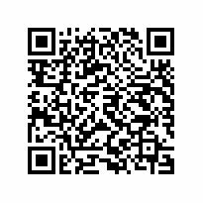
ORN Evaluation Survey Link
The grant that provided funding for this training requires that we request you to complete the brief survey linked below. Your feedback is important and provides support for this type of work to continue. Scan the QR Code to access the SAMHSA feedback survey.
Insert QR Code
Link to Survey: GPRA Survey
The survey will ask about your satisfaction with the training program you just completed as well as some basic demographic information. Your responses will help the Opioid Response Network improve the services they provide.
Thank you in advance for completing this survey!

