Slide 1
ONAP Updates:
Focus Areas, NHAS, and 2025
NASTAD Meeting
October 17, 2024
Francisco Ruiz, MS
Director, Office of National AIDS Policy
The White House

Slide 2
ONAP Focus Areas
– Science, Progress, & Equity –

Slide 3
Three ONAP Focus Areas
Modernize Policies Based on Science
Accelerate Progress in Our HIV Response
Advance Equity & Access

Slide 4
ONAP Focus Areas – Modernize Policies Based on Science
Employment Policies: Conduct an assessment across the federal government to update outdated policies related to employment eligibility for people with HIV.
Clinical Guidelines: Work with federal agencies, scientific community, healthcare professionals and community members to promote understanding and implementation of revised policies that ensuring equitable access to life-saving procedures and science for people with HIV.
Health Education Curricula: Ensure our youth receive accurate and non-discriminatory information about their health and well-being.
HIV Criminalization: Work with partners to assess and modernize laws that criminalize HIV status, ensuring they are based on current scientific knowledge and do not perpetuate stigma or injustice.
Notes:
The Biden-Harris Administration is committed to ensuring our policies are grounded in the latest scientific evidence and not driven by fear. We must embrace and advance science.
This work requires government officials at all levels, researchers and scientists, public health workforces and people with HIV to be active contributors …
This touches areas of employment, research, education of our youth, and justice systems.
Employment Policies: Review and revise to eliminate discrimination.
Organ Transplant and Clinical Trials: Ensure equitable access for people with HIV.
Sexual Health Education: Update curricula to be accurate and inclusive.
HIV Criminalization: Modernize laws to reflect current science and reduce stigma.

Slide 5
ONAP Focus Areas – Accelerate Progress in Our HIV Response
Federal Coordination: Strengthen collaboration by supporting data synchronization, co-hosting community engagement activities, cross-sharing TA resources and trainings, and exploring funding efficiencies.
Viral Suppression: Enhance efforts to increase viral suppression rates through tailored interventions, expanded access to antiretroviral therapy, and comprehensive support services.
Syndemics Approach: Accelerate approaches that address the interconnected epidemics of HIV, STIs, viral hepatitis, substance use and mental health disorders.
Translational Research: Foster collaboration across federal entities to translate innovative research ideas into implemented programs nationwide.
Congressional Champions: Continue to lay groundwork for additional congressional champions on HIV.
Notes:
Accelerating Progress in Our HIV Response means leaning into existing momentums and igniting new ones …
Federal Coordination: Strengthen collaboration by supporting data synchronization, co-hosting community engagement activities, cross-pollinating TA resources and trainings, and exploring funding efficiencies … like braiding funds.
Viral Suppression: Enhance efforts to increase viral suppression rates through tailored interventions, expanded access to antiretroviral therapy, and comprehensive support services.
Address interconnected epidemics and adopt holistic and intersectional responses.
Streamline translation of HIV research into effective programs and policies..
Congressional Champions: Continue to lay groundwork for congressional champions on HIV.

Slide 6
ONAP Focus Areas – Advance Equity & Access
HIV and Aging: Continue efforts across the federal government to strengthen existing programs and assess gaps in services for people aging with HIV.
PrEP Access Expansion: Collaborate across federal agencies to increase PrEP accessibility and affordability.
HIV Workforce Pipeline: Sustain and support current workforce while cultivating and empowering the next generation.
Non-Traditional Partner Engagement: Elevate the involvement of non-traditional partners to leverage their influence, expertise, and platforms for HIV education and service delivery.
Notes:
Address the growing number of older adults living with HIV. Continue efforts across the federal government to strengthen existing programs and assess gaps in services.
PrEP Access Expansion: Collaborate across federal agencies to increase PrEP accessibility and affordability. That means expanding policies and partnerships.
Support and retain current workforce. Develop incentives to attract new talent. Foster diversity and inclusion within the workforce.
Non-Traditional Partner Engagement: Elevate the involvement of non-traditional partners, such as businesses, faith-based institutions, and civic and social organizations, to leverage their influence, expertise, and platforms for HIV prevention and education efforts.

Slide 7
July 31, 2024
Rising Leaders Summit: Shaping the Future of HIV Today
Notes:
The summit brought together over 50 emerging leaders from across the United States and Puerto Rico, reflecting diverse backgrounds.
The convening focused on continued efforts to foster innovation, and develop new and impactful ideas that will advance the nation's HIV response, and included intergenerational panel bringing together voices that have historically shaped our HIV response with those currently driving change.

Slide 8
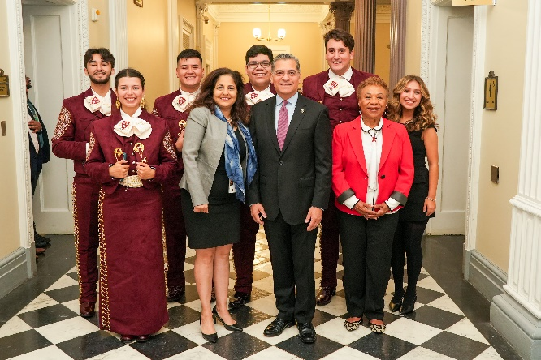
September 24, 2024
¡Adelante! Summit: A White House Convening to Accelerate Our Nation's HIV Response in Hispanic/Latino Communities
Notes:
Over eighty participants joined the summit in person at the White House and hundreds more participated virtually.
The ¡Adelante! Summit was in response to the most recent data from CDC
While Hispanic/Latino people make up approximately 19% of the U.S. population, they accounted for nearly 33% of all new HIV diagnoses in 2022.
Notably, Hispanic/Latino gay men now represent the highest number of new HIV cases in the country
HHS Secretary Becerra
Representative Barbara Lee

Slide 9
National HIV/AIDS Strategy
– Present & Future –

Slide 10
Current NHAS
Developing the 2026-2030 NHAS
Published in 2021
Spans 2022 through end of calendar year 2025
Next NHAS will span 2026-2030
Development of the next NHAS is underway
Notes:
As you know, our current National HIV/AIDS Strategy was published in 2021 and continues through the end of calendar year 2025.
Part of my role at the WH involves working across federal agencies and with nonfederal partners in communities across the country to implement the Strategy and monitor our progress.
We have also begun work to develop the next edition of the National HIV/AIDS Strategy which will span 2026-2030.

Slide 11
Next NHAS Being Developed in Parallel with Next Editions of 3 National Strategic Plans for 2026-2030
Developing the 2026-2030 NHAS
Notes:
At the same time, many if not most of your agencies are also collaborating on the development of the next editions of 3 other important national strategic plans focused on STIs, viral hepatitis, and vaccines. Those strategic plans are led by the HHS Office of Infectious Disease and HIV/AIDS Policy or OIDP and will also have new editions for 2026-2030.
Fortunately for all of us, OIDP is also supporting development of the next National HIV/AIDS Strategy…thankful for the staff and contractor support they are providing…
Developing the next editions of these plans concurrently makes sense for several reasons. First, we want to foster more coordinated responses across all of these issues since they impact many of the same populations and engage many of the same public health, clinical care, and research partners in communities.
In addition, the plans involve many the same federal agencies and programs, so we hope there may be some efficiency in doing this work concurrently.

Slide 12
Gathering Community Input to Inform Next NHAS & Strategic Plans
Developing the 2026-2030 NHAS
Recent Listening Sessions
Ryan White National Conference (August 2024)
U.S. Conference on HIV/AIDS (September 2024)
Collaboration in Care Conference: Empowered Aging, Thriving Beyond HIV (September 2024)
Upcoming Listening Sessions
Syndemic Listening Session (October 29, 2-3:30)
General Natl Strategic Plans (November 13th, 2-3:30)
General Natl Strategic Plans - En Español (November 14th, 2-3:30)
Partner-led Engagements
NASTAD
Positive Women’s Network
Southern AIDS Coalition
Request for Information
Solicits input online from anyone
Open for 60 days
Closes on December 6
Notes:
Building on what we’ve heard through other listening sessions and community engagement opportunities over the past year, we’re organizing several opportunities for people to share ideas and input on the next NHAS, including several listening sessions that have occurred in the past 2 months and more to come.
During these listening sessions, we are inviting input on the next NHAS as well as the next STI, Viral Hepatitis, and Vaccines National Strategic Plans…

Slide 13
Additional Next Steps
Developing the 2026-2030 NHAS
Synthesize all the input received
Quality of Life Symposium (~December 5, 2024)
Convene NHAS Federal Implementation Workgroup
NHAS Indicator Workgroup
Federal “Centered Conversations” on PrEP, Social Determinants of Health and Quality of Life

Slide 14
FRANCISCO.RUIZ@WHO.EOP.GOV

