Slide 1
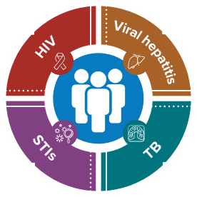
Framing a Syndemic Approach
National Center for HIV, Viral Hepatitis, STD, and TB Prevention
Jonathan Mermin, MD, MPH
Director, National Center for HIV, Viral Hepatitis, STD, and TB Prevention, CDC
2024 NASTAD Meeting
Thursday, October 17, 2024

Slide 2
In U.S. HIV incidence is declining; prevalence is increasing
Tens of billions of dollars saved
1.2 million people with HIV
>50% increase since 1996
https://www.cdc.gov/hiv/library/reports/hiv-surveillance.html

Slide 3
Over 2.5 million cases of STIs each year
Chlamydia cases
Gonorrhea cases
Syphilis cases
All stages
Congenital syphilis cases
2013 | 2022
2013 | 2022
2013 | 2022
2013 | 2022
1,401,906 | 1,649,716
333,004 | 648,056
56,485 | 207,255
362 | 3,755

Slide 4
Viral hepatitis kills thousands of Americans annually and is a leading cause of liver cancer
Number of Americans living with viral hepatitis
Hepatitis B: 660,000 Hepatitis C: 2.4 million

Slide 5
Recent increasing incidence of TB
TB cases increasing
Up to 13 million Americans live with latent TB infection
State and local health departments responsible for TB control, including outbreaks

Slide 6
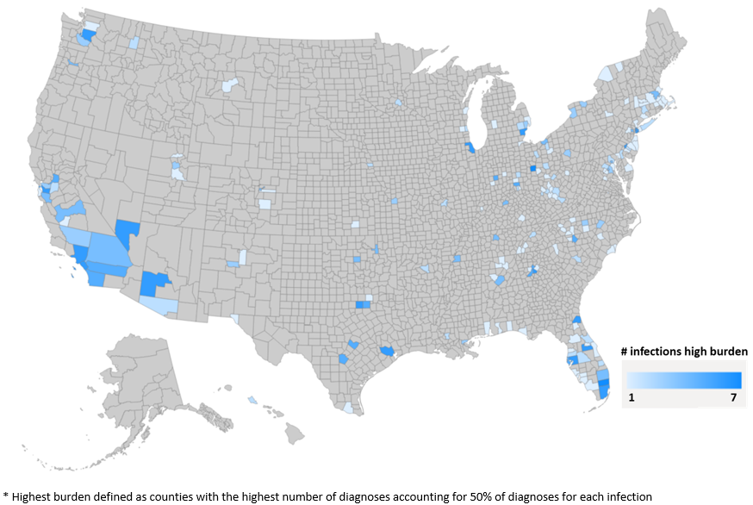
U.S. counties with highest burden* for HIV, chlamydia, gonorrhea, acute HBV, acute HCV, syphilis, and/or TB

Slide 7
Syndemic framework for public health

Slide 8
What has prevented a syndemic approach?
Organizational structures, funding silos
Multiple surveillance systems
Communication and programmatic parsimony
Fear of mission drift

Slide 9
Prioritize
Implementing everything means getting little done
Geography and populations
Put your money where your epidemics are
Choose interventions and implement them well
Disease specific and syndemic perspectives
Evaluate and revise

Slide 10
NCHHSTP workforce

Slide 11
NCHHSTP workforce
NCHHSTP has a greater percentage of employees who are members of racial and ethnic minority groups than civilian workforce overall and the total U.S. civilian workforce
56%
NCHHSTP racial/ethnic minority workforce
41%
Federal civilian racial/ethnic minority workforce
44%
Total civilian racial/ethnic minority workforce
Black/African American and Asian employees are represented at greater percentages in NCHHSTP compared with the federal civilian workforce overall and the total U.S. civilian workforce. However, Hispanic/Latino employees are represented at a lower percentage.
https://www.cdc.gov/nchhstp/equity-initiative/workforce-race-ethnicity-gender.html

Slide 12
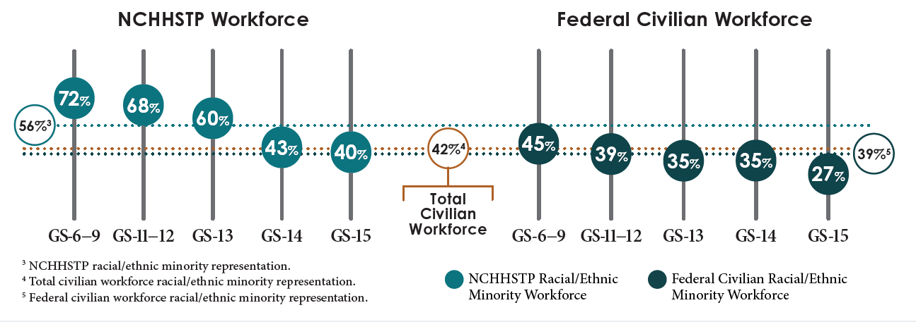
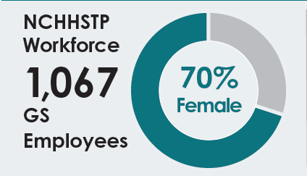
NCHHSTP workforce diversity from 2014-2024
Racial/ethnic minority representation in NCHHSTP workforce increased from 52% to 56% between 2014 and 2024
https://www.cdc.gov/nchhstp/equity-initiative/workforce-diversity.html

Slide 13
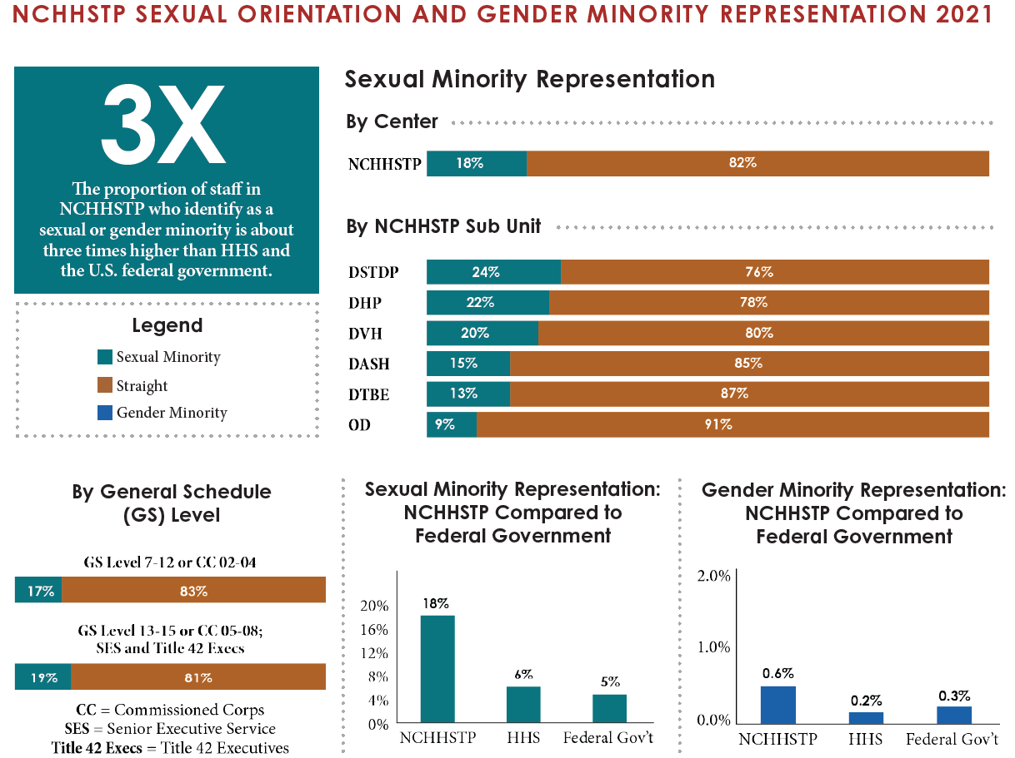
Note: At the time of this survey, the Division of Adolescent and School Health (DASH) was part of NCHHSTP and is included in the survey results. As of FY24, DASH is no longer part of NCHHSTP and has been reorganized under CDC’s the National Center for Chronic Disease Prevention and Health Promotion.
Reference: https://www.cdc.gov/nchhstp/equity-initiative/workforce-sexual-orientation-gender-identity.html

