Slide 1
NASTAD’s 2024 National HIV and Hepatitis Technical Assistance Meeting Call to Action: Investing in BIPOC Leadership October 17, 2024
Laura Cheever, MD, ScM
Associate Administrator
HIV/AIDS Bureau (HAB)

Slide 2
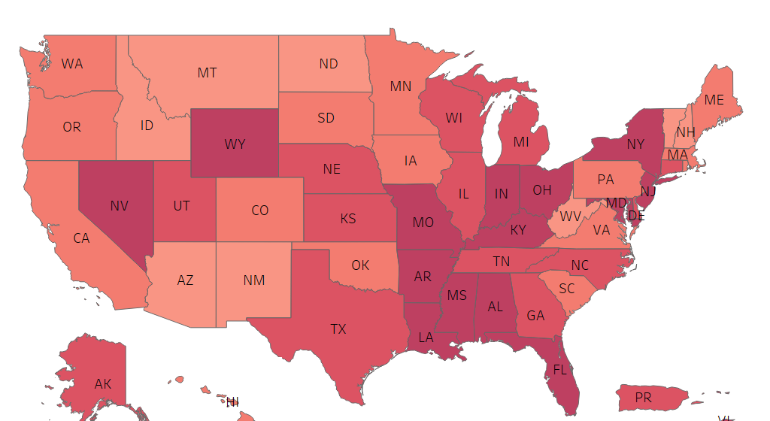
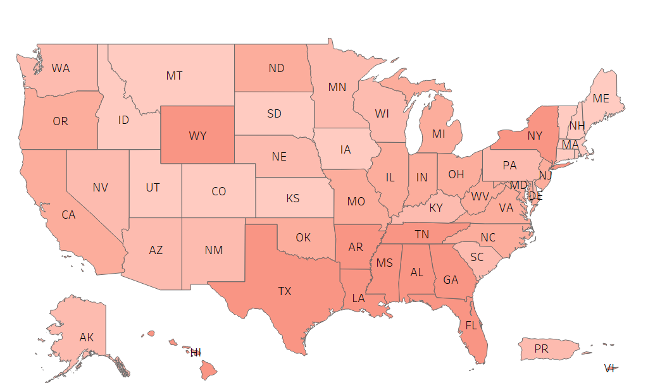
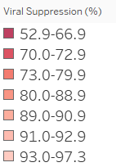
Viral Suppression among RWHAP Clients by State, 2010 and 2022—United States and 2 Territoriesª
89.6%
IN 2022
VIRALLY SUPPRESSED
69.5%
IN 2010
VIRALLY SUPPRESSED
ª Puerto Rico and the U.S. Virgin Islands.
Source: HRSA. Ryan White HIV/AIDS Program Data Report (RSR) 2022. Does not include AIDS Drug Assistance Program data.

Slide 3
Significant progress has been made in viral suppression among priority populations, 2010 and 2022
20.1
24.9
23.1
Inequities remain among priority populations:
Blacks/African Americans
Transgender people
Youth (13–24 years)
People with unstable housing
RWHAP overall, 2022 (89.6%)
RWHAP overall, 2010 (69.5%)
2010
2022
23.8
37.2
23.6%
Source: HRSA. Ryan White HIV/AIDS Program Data Report (RSR) 2022. Does not include AIDS Drug Assistance Program data.
Notes:
In this chart, I am showing viral suppression among various priority populations served by the RWHAP. It shows a side-by-side comparison of viral suppression for each subpopulation in 2010 in the shaded bar and in 2022 in the solid gray color.
All the way on the left hand side of the graph, you can see viral suppression for RWHAP clients overall in 2010 was 69.5% as indicated by the dark blue bar and the dark blue dotted line extending across the graph. In 2022, overall viral suppression was 89.6% as indicated by the light blueish gray bar and its corresponding line. This data reflects a 20.1 percentage point increase in viral suppression from 2010 to 2022.
It’s great to note that this upward trend in viral suppression occurred across all priority populations. However, despite this significant progress in viral suppression, inequities remain, particularly among Black/African American clients, transgender clients, youth aged 13–24 years, and clients with unstable housing.
Over the next few slides I am going to highlight some more specific viral suppression successes we are seeing.

Slide 4
Ryan White Program 2030: Vision
HRSA HAB’s vision of optimal HIV care and treatment for all to end the HIV epidemic in the U.S. calls us to focus on:
REACHING PEOPLE WITH HIV WHO ARE OUT OF CARE
LEVERAGE PARTNERSHIPS
COMMUNITY ENGAGEMENT
FOCUS INTERVEN-TIONS

Slide 5
HRSA’s HIV/AIDS Bureau (HAB) Ending the HIV Epidemic in the U.S. (EHE) Initiative Data: 2022
¹ Centers for Disease Control and Prevention. Vital Signs: Ending the HIV Epidemic—HIV Treatment Is Prevention. https://www.cdc.gov/vitalsigns/end-hiv.
² Estimated based on numbers of total clients served, new clients, and existing clients reported by outpatient ambulatory health services, medical case management, non-medical case management, and EHE initiative service providers.
³ Individuals may be counted in multiple years and percentages are not intended to be summed across years. Centers for Disease Control and Prevention.
NCHHSTP AtlasPlus. https://www.cdc.gov/nchhstp/about/atlasplus.html. Accessed June 6, 2024.
Source: HRSA HAB. Ryan White HIV/AIDS Program Ending the HIV Epidemic in the US Initiative Data Report 2022.
Notes:
Heather

Slide 6
Budget History: Ryan White HIV/AIDS Program Appropriations FY1991 - FY2024
*Part B Base includes
Emerging Communities

Slide 7
Contact Information
Laura Cheever, MD, SCM
Associate Administrator
HIV/AIDS Bureau
Health Resources and Services Administration
Email: LCheever@hrsa.gov
Web: ryanwhite.hrsa.gov
Connect with HRSA
Learn more about our agency at:
www.HRSA.gov
Sign up for the HRSA eNews
FOLLOW US:
7

