Slide 1
International Day to End Violence Against Sex Workers
Robyn Learned
Notes:
This day was created in to call attention to hate crimes committed against sex workers all over the globe. Inaugurated by Dr Annie Sprinkle and started by the Sex Workers Outreach Project USA, the first annual day was in 2003 and was a memorial and vigil for the victims of the Green River Killer in Seattle Washington. International Day to End Violence Against Sex Workers has empowered workers from over cities around the world to come together and organise against discrimination and remember victims of violence.

Slide 2
SWOP was founded in 2003 in the Bay Area, with it’s first major action being the coordination of International Day to End Violence Against Sex Workers, a global vigil that continues to be a cornerstone of SWOP’s awareness-raising work. Since it’s founding, hundreds of individual activists have engaged in local SWOP chapters and national projects geared towards educating the public and policy-makers on the direct and institutional harms committed against sex workers and their communities.
SWOP promotes decriminalization as the best means of decreasing harm and promoting agency amongst people in the sex trade. SWOP adopts the principles and practices of nonviolent action in order to reduce violence and achieve dignity and rights for sex workers. SWOP is committed to the respect, safety, and autonomy of all sex workers, and seeks to amplify the voices of those who are often left out of discourse around the issues we address colletively as a social justice movement.

Slide 3
A look back in time:
Worship of Inanna
Her temple at Uruk was her central cult center but throughout Mesopotamia her temples and shrines were numerous and sacred prostitutes, of both genders, were employed to ensure the fertility of the earth and the continued prosperity of the communities. Male transgender folks, known as kurgarra, castrated themselves, females who identified as males were known as galatur; both were thought to have either been transformed by Inanna/Ishtar herself or created by the Father God Enki to rescue Inanna from the underworld. The Descent of Inanna notes that Enki made them "neither male nor female" and the clergy of Inanna's temple honored this tradition by embodying it. Scholar Colin Spencer comments:
Sacred prostiution was the central part of the ritual in the Temple. The priestess performed a sacred marriage to ensure the fertility of the country and the great fortune of the new king, for the king copulated with the holy priestess at the beginning of his reign. There were lesser priestesses who were also musicians, singers, and dancers, certainly some of these were men who also copulated with both men and women. The goddess Ishtar had turned these men into women as a demonstration of her awesome powers. Yet though Ishtar was an all-powerful presence and through prostitution was revered and was also an important economic factor in the running of the Temple, women's role in society began to be secondary to that of men. (29)
Inanna continued as a powerful and popular goddess until the decline of the prestige of female deities during the reign of Hammurabi which, according to scholar Samuel Noah Kramer, coincides with women's loss of status and rights in society. Still, as Ishtar of the Assyrians, she continued to be widely venerated and inspired the visions of similar deities in other cultures of the Near East and beyond.
Notes:
Going back close to 5000 years in the human story, these are some of the earliest documented examples of the sacredness of sex work and the place trans and queer folks had in it as well.
We also know that sex work was such a major industry in Rome at one time , that what we would consider brothels were not allowed to open unitl mid-afternoon, otherwise the fear was that nothing would ever get done.
There is a great episode of Ancient World on Discovery that Pompei was a city almost completely built around the sex industry.
Also i just wanted add thius caveat … when i talk about sex workers today I am talking about Everyone across all gender, orientation and presentation spectrums.

Slide 4
Sex Workers helped to ‘settle’ the American West
Notes:
Here is a fun little video to really demonstrate how much of our contributions have been written out of mainstream human history. In fact, who knew that the real colonization of the old west was mainly driven by sex workers …
and damn go Wyoming… who knew they were so progressive?

Slide 5
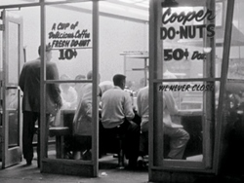
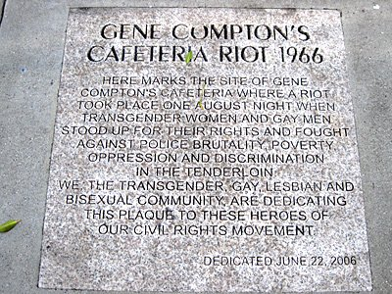
The next century…
1959 - Cooper's Donuts Los Angeles
1966 - Compton's Cafeteria San Francisco
To the historian Mack Friedman, the Compton’s Cafeteria riot represented “an expression of pangender sex worker unity in the face of an affront.” Yet the role played by full- or part-time (people engaged in sex work) is often forgotten in the thumbnail histories of these uprisings.
1966 - Vanguard
The historian Laura Renata Martin said this, “(for) Vanguard, resistance to the criminalization of sex work and police targeting of sex workers was woven in with resistance to harassment based on gender expression and sexual identity.”[1]
Notes:
Jumping forward to 1959 we come to Cooper’s a well known an all-night hangout for gay people, drag queens, transgender and gender-nonconforming folks, and “hustlers”—part- or full-time sex workers.
LAPD “who prided itself on being one of the most determined enemies of homosexuality in the nation,” came in and randomly picked three people to ‘arrest’,
but that night the donuts and coffee started flying and the cops had to run out the door.
I wonder if that was the first time cops ran from donuts...
The “Compton Riot” is almost the same story as Cooper’s again it was the transwomen of color, the sex workers and ‘gender queer’ non-conforming that standing tall and throwing things, in fact, the biggest common denominator of all of these protests, actions and riots was the sex workers and more specically the trans and GNC sex workers.
Sex workers not only participated in nearly all of the iconic queer uprisings of the era, but in reality they helped create the conditions that made such uprisings possible.
In San Francisco, for instance, a group of street youth — largely trans and queer kids, many of whom sold sex in the Tenderloin — came together in 1966 to form a new organization called Vanguard. By publishing a revelatory newsletter, meeting with city officials and organizing actions, marches and speeches, members of Vanguard raised awareness about the conditions faced by those on the streets.

Slide 6
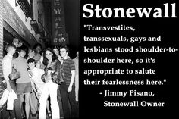
1969 - Stonewall
The story of one June night in 1969 in
Greenwich Village often doesn’t mention
how the outlaws and outcasts who
patronized the Stonewall Inn
“made their living,” the historian
Melinda Chateauvert has commented.
As the historian Susan Stryker has argued, transgender women—among the most marginalized members of the queer community—were often the instigators of ALL these uprisings.
The uprising at Stonewall was a fight for the rights of trans people, gender-nonconforming people, queer people of color, homeless queer people—and queer sex workers.
Notes:
But many of the queers who threw bottles, bricks and garbage at the police that night were hustlers, hookers and other sex workers. Indeed, Marsha P. Johnson and Sylvia Rivera — two trans women of color who have both been credited with throwing the proverbial “first brick” at Stonewall and who are being honored for their activism with a new monument in New York City — had sold sex.

Slide 7
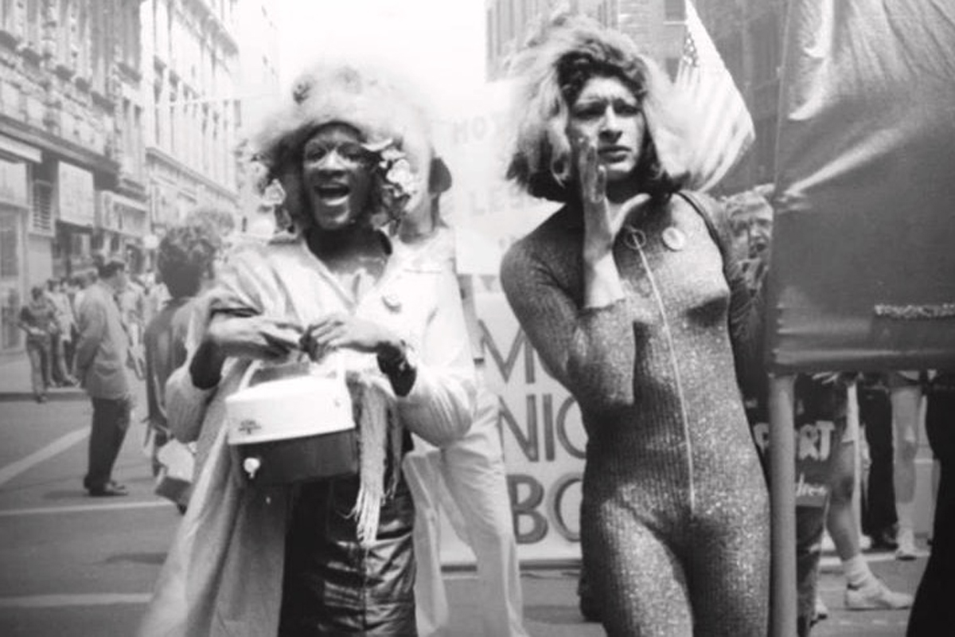
Marsha P Johnson Sylvia Rivera
The (sex) work was “the only alternative that we have to survive because the laws do not give us the right to go and get a job the way we feel comfortable,” Rivera once said.
According to Johnson, it was possible for trans women to hold down “straight” jobs at this time, but only if they hid who they were:
“I think it will be quite a while before a natural transvestite will be able to get a job,” she once said, using the parlance of the time.
Notes:
In the years following Stonewall, Rivera and other sex workers united in the Gay Liberation Front and Street Transvestite Action Revolutionaries,both of these organizations were launched from organizing campaigns to combat discrimination, demand acceptance of gender and sexual nonconformity, and ultimately call for the overthrow of capitalism.
And, because…capitalism the erasure of sex workers and the origins of the gender queer, gender non-conforming and the transwomen of color from Stonewall began almost immediately.
As early as 1973, “Rivera had to fight to speak at the gay pride rally celebrating Stonewall because the crowd didn’t want to hear from a transgender sex worker.”
This was almost 50 years ago, for some of us a lot has changed since then, unfortunately for most trans and gender queer people of color this is still true today.

Slide 8
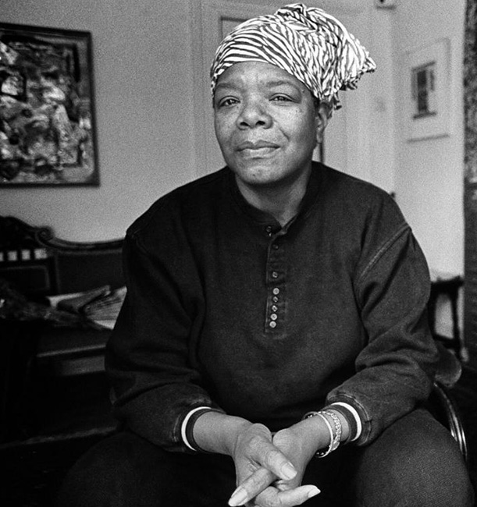
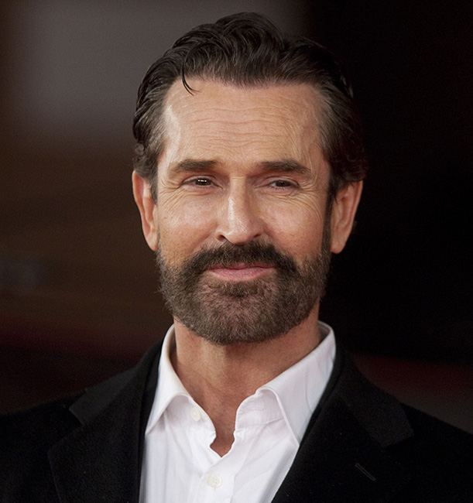
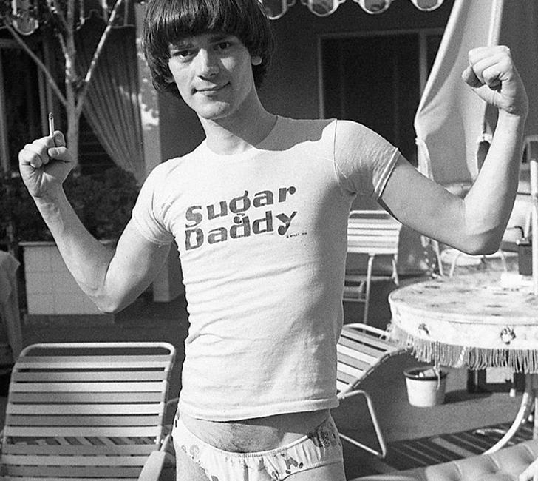
Did you know?
Maya Angelou Poet, Activist, Author
Rupert Everett English actor, novelist and one-time New Wave singer
Kathleen Hanna is widely known as the frontwoman for Bikini Kill, Le Tigre and The Julie Ruin
Amanda Palmer musician and hugely polarizing internet personality, first became known as half of Boston-based duo The Dresden Dolls.
Dee Dee Ramone Bassist and co-founder of legendary punk band The Ramones,
6 Famous People You Didn’t Realize Were Sex Workers written by Matthew Lawrence on January 3, 2021
Notes:
Dr. Maya Angelou only ever earned honorary degrees, but she did have quite a variety of jobs over the years. You probably know her as a poet and memoirist, but if you’ve actually read her series of memoirs then you know she was at various times also a calypso singer, a Tony-nominated Broadway actress, a paint scraper at a body shop and San Francisco’s first female streetcar driver. When she was fairly young, Angelou worked as a prostitute and brothel manager, activities which she describes candidly in her 1974 memoir Gather Together In My Name:
English actor, novelist and one-time New Wave singer Rupert Everett was born into a wealthy family, but he spent his younger days escorting his way through college. His first film role, playing a gay character in 1984’s Another Country, made him a star, and he came out of the closet. Never shy about expressing his feelings, he revealed his past as a former rentboy in 1997 while promoting the career-reviving My Best Friend’s Wedding. He also hosted an interview series on British television entitled Love For Sale about various British sex workers.

Slide 9
Pop Stars who started as Strippers
Cardi B
Chris Pratt
Lady Gaga
Mark Consuelos
Brad Pitt
Channing Tatum
Carmen Electra
Amber Rose
Azealia Banks
Roseanne Barr
https://popcrush.com/celebrities-sex-workers/
Notes:
I mention all of these folks just as a reminder that just like with gay and trans folks … someone you know and love is or has been a sex worker…

Slide 10
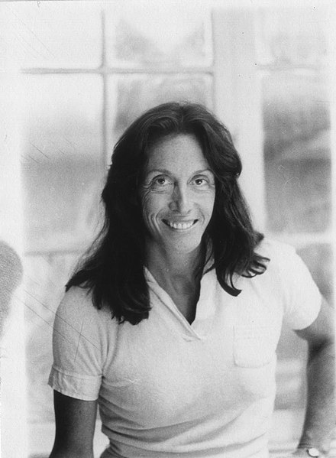
A Moment of Silence to Honor and Remember Ms. Margo St. James
Margo St. James founded COYOTE (Call Off Your Old Tired Ethics), an organization for sex workers' rights, in 1973. Its forerunner was WHO: Whores, Housewives and Others, the "others" being lesbians.To finance COYOTE and its newspaper, COYOTE HOWLS, she organized annual Hooker's Balls; the highest attendance was 20,000 in 1978.
She also organized similar organizations in other states, lectured in 1974 on college campuses including Harvard, and in 1976 attended both the Democratic and Republican National Conventions, organizing "loiter-ins" at the former In 1984, with the scholar Gail Pheterson and coinciding with the Democratic National Convention in San Francisco, she organized the Women's Forum on Prostitutes' Rights and the COYOTE Convention.^{[2]} She also attended the United Nations Decade Face of Women Conferences in Mexico City, the 1976 Tribunal of Crimes Against Women in Brussels, the 1977 International Women's Year Conference in Houston, the 1977 Libertarian Party Convention, and the 1980 Decade of Women Conference in Copenhagen.
From 1985 to 1994 she lived with Pheterson in the Netherlands and then the South of France. They co-founded the International Committee for Prostitutes' Rights and organized the first and second World Whores' Congresses, held in Amsterdam in 1985 and at the European Parliament in Brussels in 1986, which led to the World Charter for Prostitutes' Rights.
After her return from Europe, in the 1990s she was appointed to the San Francisco Task Force on Prostitution and in 1999 was one of three founders of the St. James Infirmary Clinic in the Tenderloin, which provides health care to the sex worker community. She also served on the Board of Supervisors' Drug Abuse Advisory Board.
St. James sought the Republican Party nomination for President of the United States in 1980. In 1996 she narrowly failed to win election to the San Francisco Board of Supervisors; she ran on the slogan "The Lady Is a ... Champ" and promised to have a red light illuminated outside City Hall when she was there.
Notes:
And now I would like us all to please stop whatever else we may be doing, I know its a busy Friday afternoon… I would like to dedicate this minute of silence to one of my personal sheros Ms Margo St. James. After being arrested for prostitution in 1962 (the judge convicted her because she knew the word ‘trick’) she would go on to spend the majority of her life fighting for sex workers rights around the world. Her presence is missed in our world.
After a minute please feel free to unmute yourselves and speak a name of someone in our community who has passed this year, or please go ahead and add it in the chat if that is more comfortable.

Slide 11
Nothing About us Without Us…
Introducing our Amazing Panel of Experts…

Slide 12
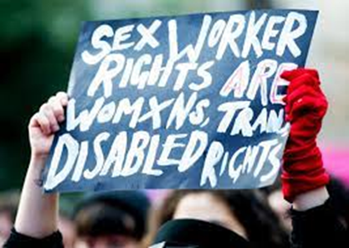
Actions for 2022
We urge the Biden administration to:
Rescind National Security Presidential Directive 22,3 which falsely conflates all sex work with human trafficking and creates barriers throughout the federal government to recognizing the dignity of sex workers or their importance as stakeholders in the fight against trafficking.4
Require all federal departments to adopt a policy barring sexual contact while operating under color of law.
Require criminal law modernization to eliminate the use of condoms or other measures to prevent HIV transmission as the basis for criminal prosecution or sentence enhancement

Slide 13
RECOGNIZE AND PROTECT THE RIGHTS OF SEX WORKERS
The SAFE SEX Workers Study Act of 2019 is sitting in the Committee on Health, Education, Labor and Pensions, this bill needs to be passed to authorize an investigation into the harms done by FOSTA/SESTA laws enacted in 2018.
Closing the Law Enforcement Consent Loophole Act of 2021. This bill makes it unlawful for federal law enforcement officers to engage in a sexual act while acting under color of law or with an individual who is under arrest, in detention or in custody. It is sitting in the House Judiciary Subcommittee on Crime, Terrorism, and Homeland Security.
Prevent the passage of the EARN IT Act of 2020, which, similarly to FOSTA/SESTA, incentivizes private Internet platforms to surveil and censor the public. Sex workers warn the bill will further undermine their ability to use technology to screen clients, negotiate prices and meeting places, share safety information with colleagues and find accepting and affirming health care. This bill is still in committee.
Prevent the passage of the Reducing the Demand for Human Trafficking Act of 2021, which would prioritize trafficking grants that included an attestation that money “will be used in part to assist in strengthening efforts to reduce demand for human trafficking through the investigation and prosecution of persons who solicit or purchase commercial sex.” This bill is also still in committee.

