Slide 1
Harm Reduction and Syringe Access
NASTAD Drug User Health
National Harm Reduction TA Center
Notes:
Welcome! This training discusses the foundations of harm reduction and how it has been used to develop effective and community-driven public health resources for people who use drugs. Presentation slides can be explored as-is or downloaded and updated to include context, data, and resources for your area or jurisdiction. Please check the slide notes for additional information or recommendations for presenting.
Please contact DrugUserHealthTA@NASTAD.org with any questions about this content or other educational resources.
Funds to support the development, review, and release of this training were made possible through Centers for Disease Control and Prevention Notice of Funding Opportunity (NOFO) 19-1909, the National Harm Reduction TA Center.
Many thanks to subject matter experts Heather Edney (CA), Joy Rucker (HI), and Kacey Byczek (KY) for training development and review.

Slide 2
Training Goals
The goal of this training is to increase participants’ understanding and awareness of:
Harm reduction philosophy and practice
Drug user health issues and trends
Cultural competence and humility when working with drug users
Notes:
Intended audience includes:
State and tribal health department staff working with drug user health programs, harm reduction programs, or other public health services for people who use drugs;
Syringe access program staff, participants, or community members/partners;
General public seeking information on harm reduction and drug user health
This content assumes some familiarity with terms and ideas associated with drug use, drug user health, and substance use disorder. Please contact DrugUserHealthTA@NASTAD.org with any questions about this content or other educational resources.

Slide 3
Learning Objectives
By the end of this training, participants will be able to:
Define harm reduction
Describe the principles of harm reduction practice
Provide examples of harm reduction for people who use drugs
Understand the significance of syringe access and safer drug use for individual and public health
Increase knowledge of health and social risk factors related to injecting, smoking, and snorting substances

Slide 4
Training Overview
Values clarification exercise
Why harm reduction?
Harm reduction values and principles
Drug use and harm reduction
Notes:
Please visit www.NASTAD.org for additional trainings and resources for drug user health and harm reduction programming. Contact DrugUserHealthTA@NASTAD.org with any questions.

Slide 5
Public Health Acronyms
PWID | Person who Injects Drugs
PWUD | Person who Uses Drugs
PLWH(A) | Person Living with HIV(/AIDS)
SSP | Syringe Services Program
SAP | Syringe Access Program
NEP/NEX | Needle Exchange Program, Needle Exchange
HAV, HBV, HCV | Hepatitis A, B, C Virus
HIV | Human Immunodeficiency Virus
SSTI | Skin & Soft Tissue Infection
STI | Sexually Transmitted Infection
CDC | Centers for Disease Control and Prevention
SUD | Substance Use Disorder
OUD | Opioid Use Disorder
MOUD/MAT | Medications for Opioid Use Disorder/Medication-Assisted Treatment
Notes:
“Syringe Access” vs. “Needle Exchange”
“Syringe access” includes but is not limited to syringe services programs, and might include syringe access through other sources, like pharmacies or community health clinics. “Needle exchange” is an early term for SSP, focusing on program functions of collecting used syringes and distributing sterile injection supplies.
If facilitating a group training:
Take time to briefly review the acronyms. Ask for feedback on whether these terms are familiar, or which may have changed over the years. Are there other terms you should add to the list?
Note that language is fluid and always changing—staying in contact with people in active use and being open to feedback on terminology is a great way to make sure you’re using current and appropriate language.

Slide 6
Values Clarification Activity
Notes:
This activity can be used to identify our own values and attitudes toward drug use and people who use drugs, and how they inform health and safety.

Slide 7
On Your Own
Review the statements on Slide 10. You can also download the Drug Use Values Clarification Worksheet in the Training Resources.
Silently reflect on each statement and your level of agreement/disagreement. You can fill out the survey if you want to or keep your responses in your head.
There are no right or wrong answers.
When you’ve reflected on each statement, go to Slide 10.
Notes:
If going through this training on your own, use these instructions to complete the Values Clarification activity.

Slide 8
In a Group
Review the statements on Slide 10. You can also download the Drug Use Values Clarification Worksheet in the Training Resources.
Ask participants to silently reflect on each statement. Emphasize that there are no right or wrong answers, and that this is not a test. Participants can fill out the survey if using worksheets or keep their responses in their heads.
When participants have reflected on each statement, go to Slide 11 and discuss prompts as a group.
Notes:
If facilitating a group training, use these instructions to complete the Values Clarification activity.

Slide 9
1. Drugs kill people.
2. Addiction is a disease.
3. Drug use can be a useful way to cope with stress, depression, and mental illness.
4. Most people who inject drugs don’t consider their health a priority.
5. Sometimes I feel sorry for people who inject drugs.
6. Abstinence is the ultimate goal of harm reduction activities.
7. Crack possession is punished more than powder cocaine because crack makes people lose control of themselves and become violent.
8. People on methadone still want to get high, otherwise they would just get “clean” from all drugs.
9. It should be a crime to expose a fetus to harmful or addictive substances.
10. Harm reduction does not promote drug use.
What do you think about each statement? Give your honest opinion–there are no right or wrong answers. Read each statement carefully and assign it a numbered response from the scale below.
1: Totally disagree
2: Disagree
3: Unsure
4: Agree
5: Totally agree
Notes:
You can also download the Values Clarification worksheet here: https://www.nastad.org/sites/default/files/Uploads/drug_use_values_clarification_worksheet_for_dhmh.pdf.

Slide 10
Values Clarification Debrief
How did it feel to think about the statements? How often do you examine these opinions?
Were there any statements that you got stuck on, or had a harder time with?
Were there statements that were more (or less) meaningful for you?
Notes:
These prompts, and others you come up with, can be used for individual reflection or group discussion.

Slide 11
The goal of this activity is to reflect on how our values and assumptions about drug use and people who use drugs can be both highly personal and shaped by social practices, laws and policies, religion, culture, and other influences.
However, stigma, discrimination, and criminalization limit opportunities for people with lived experience and direct knowledge of drug use, sex work, incarceration, and homelessness to contribute their perspectives.
What spaces exist for people to share their own stories and experiences of drug use? How might their experiences affect attitudes toward drugs and drug users?
Notes:
Direct involvement of people with experience of drug use, sex work, incarceration, and houselessness is central to harm reduction. Early harm reduction services, like syringe access, developed because drug users were able to express their experiences and needs collectively and engage with public health systems and other partners on practical solutions. Learning from people with lived experience, particularly people in active use, is important for directing priorities, shaping programs and services, identifying needed policy changes, and informing conversations and attitudes around drugs and drug use.

Slide 12
Section 1 Why harm reduction?

Slide 13
Why do we need harm reduction?
Notes:
In this training, “harm reduction” refers specifically to resources and services that aim to reduce morbidity and mortality (suffering and death) among people using drugs, engaging in sex work, and experiencing housing instability. Harm reduction as a philosophy and social justice movement centering and empowering people with experience of marginalization and criminalization is explored.
This type of harm reduction exists under an umbrella of other types of “risk reduction” or “risk avoidance.” Risk reduction is a common public health framework that emerged because communities and cultures deem certain risks reasonable or worthwhile. Risk reduction include standardized seatbelts in motor vehicles, sunscreen to prevent skin damage, bicycle helmets and hard hats, and condoms to prevent pregnancy and STI exposure.
If facilitating a group training:
Use this slide to prompt discussion about goals for harm reduction program development, local or regional trends that may inform priorities, or expectations for the training.

Slide 14
Impact of Prohibitionist Drug Policy on Health
During the twentieth century, global drug policy focused on criminalization and interdiction to reduce both supply and demand for illicit substances. This created significant consequences for individual and public health.
Stigma associated with criminalization, incarceration, mental illness, race, and class reduce opportunities for and quality of tailored medical and social services.
Criminalization and discrimination lead to worsened social determinant of health-related outcomes for people who use drugs and their communities.
This has contributed to a moralistic, rather than science-based, understanding of drug use and substance use disorder.
Under this system, possession of syringes and other supplies becomes dangerous, “a cause for suspicion,” and access is limited.
Incarceration without treatment for OUD results in increased risk for fatal overdose in the weeks following release, as compared to people who receive MOUD while incarcerated.

Slide 15
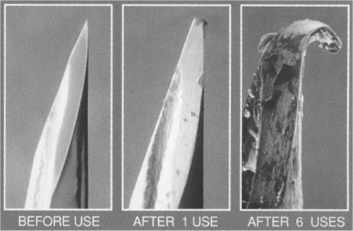
Why Are We Talking About Syringes?
Notes:
The photo on the left shows a sterile syringe before it has been used. After one use (image in the middle), there is damage to the syringe point and bevel edge. After six uses (image on the right), the point is fully blunted and curled back, and there is significant damage to the bevel. When syringe access is limited and criminalized—making it risky to carry several syringes at once and new ones hard to come by—it is not uncommon for someone to use the same syringe for several weeks at a time, or to share the same syringe between multiple people. As a syringe is used and degraded, it is more likely to trap blood and bacteria and to create jagged or uneven puncture wounds, increasing the chance of damage or infection.
It is important to remember that people who, for example, reuse a syringe multiple times to avoid suspicion from pharmacy staff are also practicing “harm reduction.” For some, avoiding police involvement or stigma from service providers is a more urgent “harm” to reduce than infections or abscesses.

Slide 16
Sterile Syringes Prevent Bacterial and Viral Infections
Bacterial infections, including:
Bacteremia
Cellulitis
Abscesses (staph, strep)
Endocarditis
Necrotizing fasciitis
Wound botulism
Infection resulting in sepsis
Viral infections (bloodborne diseases), including:
Hepatitis C virus (HCV)
Hepatitis B virus (HBV)
Hepatitis A virus (HAV)
HIV
Notes:
Bacterial infections (of the skin and soft tissues) include:
- Septicemia: More commonly known as sepsis or blood poisoning. Caused by certain Staphylococcus, E. coli, or Streptococcus bacteria entering blood stream. Symptoms include fever and chills, clammy skin, a rapid pulse, difficulty breathing, extremely painful wounds, redness/swelling around a wound, and/or red “pinpoint” dots in a line near a wound. If untreated, sepsis leads to septic shock, which is fatal. Treated with IV fluids, antibiotics, and oxygen; seek medical care.
- Bacteremia: Bacteria in the blood stream. This is often confused with sepsis (and can lead to sepsis), but unlike sepsis, bacteremia can clear up on its own in healthy individuals. Symptoms include fever, chills, shivering/shaking. Diagnosed with a blood culture, and treated with antibiotics (1-2 weeks depending on severity), and, in more extreme cases, IV fluids; seek medical care.
- Cellulitis: A bacterial SSTI often caused by strep bacteria entering the body. Caused by breaks in the skin that allow bacteria to enter the body (which is why injection drug use is a risk factor). Appears on the skin as a red, swollen, painful area (without pus, unlike an abscess), often with the texture of an orange peel or blisters. Other symptoms include fever and chills. Diagnosed via a physical exam, and treated most often with oral antibiotics (IV antibiotics for more serious infections). Complications aren’t common, but can lead to endocarditits and bacteremia; seek medical care.
- Abscesses (staph, strep): An abscess is a collection of pus at any part of the body that occurs when tissue becomes infected and the immune system tries to fight it, causing white blood cells to move into the area of infection. Pus in abscesses is a buildup of both living and dead fluid, white blood cells, other dead tissue, bacteria, and other foreign substances. On skin, abscesses are red, raised, and painful (in addition to being pus-filled), but they can occur in other body parts, where they can’t be seen. Most commonly caused by staph and strep bacteria. Most abscesses can be treated at home by applying heat (warm compresses, warm water, etc.) 4x/day and keeping it dry, clean, and covered otherwise. If abscesses don’t improve with heat treatment, a medical provider can drain and pack the abscess, and prescribe antibiotics to stave off further infection.
- Endocarditis: Inflammation of the lining of the heart chambers & valves (endocardium); usually caused by a bacterial infection. Caused by bacteria entering the bloodstream, so IDU is a risk for endocarditis. Symptoms include flu like (aches and pains, fever, fatigue, shortness of breath), swelling of extremities, chest pain, blood in urine, heart murmurs. Treated with several weeks of antibiotics, often starting with IV antibiotics in the hospital; sometimes requires a valve replacement. If untreated, infection can spread to other body parts, cause a stroke, or lead to heart failure and death; seek medical care.
- Necrotizing fasciitis: Necrotizing fasciitis is a rare disease most commonly caused by strep bacteria entering through a break in the skin. Early symptoms include redness, warmth, and swelling on the skin, as well as pain outside the swollen area, and fever. Later symptoms include ulcers, blisters, and black spots on skin, changes in skin color, oozing/pus coming from skin, dizziness, nausea/diarrhea, and fatigue. If someone suspects they have necrotizing fasciitis, it’s important to seek medical care as quickly as possible--if caught early, it’s treated with IV antibiotics. However, sometimes it can require surgeries to remove tissue killed by the bacteria and, because bacteria that cause it can reduce blood flow, patients may even need blood transfusions. Untreated, NF can lead to sepsis, shock, organ failure, and death.
- Wound botulism: A rare but very serious infection caused when the bacteria Clostridium botulinum enters an open wound and makes a toxin that attacks the body’s nerves, making it hard to breath and causing muscle weakness. Can take several days after injecting contaminated drugs for symptoms to occur--which include blurred/double vision, drooped eyelids, slurred speech, dry mouth, muscle weakness/paralysis, and difficulty breathing--to set in. With wound botulism, the injection site doesn’t always look infected. Some of the symptoms – esp. droopy eyelids, difficulty breathing, and muscle weakness, resemble signs of opioid overdose – so it’s important to call 911 if someone looks like they’re overdosing but naloxone is not helping. Wound botulism is treated with an antitoxin medicine, which will stop the toxin from doing more harm, but won’t reverse what it’s already done.
Viral infections (bloodborne infections)
- Hepatitis C (HCV): A liver infection spread by blood-to-blood contact, often from sharing syringes, cookers, or other injection equipment. People who newly acquire HCV may have acute symptoms like fatigue, joint pain, jaundice, and flu-like symptoms, but many people do not have symptoms. It progresses to chronic HCV in about 75% of people (meaning 25% clear the virus on their own), and can progress into cirrhosis if untreated. However, there are many medications that can treat and cure HCV. HCV is diagnosed in two steps: a rapid antibody test followed by a confirmatory viral load test.
- Hepatitis B (HBV): A liver infection spread by blood and other bodily fluids, caused by the hepatitis B virus. Acute symptoms resemble acute HCV symptoms, but unlike with HCV, only about 2-6% of adults who contract HBV become chronically infected. There is no cure for HBV, but there is a preventative vaccine.
- Hepatitis A (HAV): A liver infection caused by the hepatitis A virus, which is spread by stool and blood. Acute symptoms are similar to HCV symptoms and can last about two months, but HAV rarely progresses into a chronic illness. There is a vaccine for HAV but no cure. People living in close quarters and/or unhoused populations are at unique risk for HAV because of lack of access to bathrooms.
- HIV: Human immunodeficiency virus is a virus that attacks the body’s immune system, spread by blood, semen, pre-ejaculatory fluid, vaginal fluid, and breast milk. If untreated, HIV can lead to AIDS (acquired immunodeficiency syndrome). Some people have flu-like symptoms that last a few days to a few weeks 2-4 weeks after contracting the virus, but many people don’t feel sick at all. HIV is diagnosed in two steps: a rapid antibody test followed by a confirmatory viral load test. While there is no cure for HIV, there are many effective treatments, which suppress viral load to an undetectable amount, and preventative regimens. HIV-positive individuals with undetectable viral loads cannot pass the virus along via sexual contact. For people who are worried about contracting HIV, PrEP is a daily preventative medication. For people who are worried they may have contracted HIV, PEP is a 30-day course of antiretrovirals that can be started up to 72 hours after suspected HIV exposure.

Slide 17
Hepatitis A
How do you get it?
Fecal/oral contact (including sexual contact/butt play)
Contaminated food
Household contact
What does it do?
Most adults experience symptoms after infection
Causes acute infection, which usually resolves within two months
Notes:
Hepatitis infographics courtesy of Philadelphia Department of Public Health.

Slide 18
Hepatitis A
How do you stop it?
Improve hygiene to prevent contact with fecal material
Hepatitis A vaccination (available in combination with Hepatitis B vaccine)
Access care if infected

Slide 19
Hepatitis B
How do you get it?
Exposure to infected blood or body fluids
Sexual contact
Mother-to-infant (vertical transmission)
What does it do?
Causes lifelong infection
There is no cure for Hepatitis B
Long-term infection leads to liver scarring and can cause liver cancer
Often no symptoms after infection (asymptomatic)

Slide 20
Hepatitis B
How do you stop it?
Hepatitis B vaccination (available in combination with Hepatitis A vaccine)
Use new works, don’t share your supplies
Use barrier methods during sexual activity to prevent exposure to body fluids
Manage viral infection after exposure

Slide 21
Hepatitis C
How do you get it?
Used works
Sexual contact
Exposure to infected blood
What does it do?
Virus slowly attacks liver over the course of infection
Often no symptoms after infection (asymptomatic)
Long-term infection leads to liver scarring and can cause liver cancer

Slide 22
Hepatitis C
How do you stop it?
Use new works, don’t share your supplies
Use barrier methods during sexual activity to prevent exposure to body fluids
New Hepatitis C treatment regimens have high rates of success and fewer side effects.

Slide 23
Hepatitis D

Slide 24
Responding to HIV and Hepatitis C
In the United States, injection drug use accounts for:
Approximately 1 in 15 new HIV infections¹
Over 72% of HCV cases²
Among people who inject drugs:
60-90% will have HCV within 5 years of initiation
Median time for PWID HCV infection is approximately 3 years
Each year, 20-30% of PWID are infected or reinfected with HCV³
Notes:
Injection drug use is a risk factor for HIV and HCV transmission. Hepatitis C infection is especially prevalent among people injecting drugs because of long-term limited access to sterile syringes and other injection supplies. Preventing and reducing risks for HCV should be a primary goal of public health programming and service development for people injecting drugs.
1. Centers for Disease Control and Prevention, 2018. HIV Surveillance Report, https://www.cdc.gov/hiv/library/reports/hiv-surveillance/vol-31/index.html
2. Centers for Disease Control and Prevention, 2016, Surveillance for Viral Hepatitis – United States, 2018. https://www.cdc.gov/hepatitis/statistics/2018surveillance/index.htm
3. Grebely, J. et al. 2011. https://www.ncbi.nlm.nih.gov/pmc/articles/PMC3072734/

Slide 25
Hepatitis C and Injection Drug Use
Hepatitis C is the leading cause of death among all infectious diseases¹
The CDC estimates 50,300 acute HCV cases in the US in 2018¹
Estimated 2.4 million people have HCV in the US (~1% of US population)²
85% of HCV infection progresses to chronic infection¹
IDU is currently the most common risk factor for HCV in developed countries (60-80% worldwide)³
These risks are due to restricted access to safer use supplies, not drug use itself.
Notes:
Hepatitis C is a major contributor to death and suffering (mortality and morbidity) of people who inject drugs. High HCV prevalence, particularly of chronic HCV, also causes significant costs for people and healthcare systems. As a country, we have not yet begun to experience the full impact of increasing HCV. Community- and population-level consequences will increase as people age and begin to experience more effects of chronic HCV infection. Working effectively with and on behalf of people using injection drugs is integral to addressing HCV transmission and cases.
1. Centers for Disease Control and Prevention, 2016, Surveillance for Viral Hepatitis – United States, 2018. https://www.cdc.gov/hepatitis/statistics/2018surveillance/index.htm
2. U.S. Department of Health and Human Services, 2020, Viral Hepatitis in the US https://www.hhs.gov/hepatitis/learn-about-viral-hepatitis/data-and-trends/index.html#:~:text=2.4%20million%20people%20are%20estimated,as%20low%20as%202.5%20million.&text=850%2C000%20people%20in%20the%20U.S.,or%20as%20low%20as%20730%2C000.
3. Midgard, et al.., ”HCV epidemiology in high risk groups and the risk of infection”, 2016, Journal of Hepatology, https://www.journal-of-hepatology.eu/article/S0168-8278(16)30336-1/pdf#:~:text=In%20most%20developed%20countries%2C%20IDU,countries%20%5B14%E2%80%9316%5D

Slide 26
US Overdose Crisis
Between 1999 and 2020, more than 841,000 people died from drug poisoning.¹
In 2020, more than 93,000 people died from overdose, a 30% increase over the previous calendar year.
Reports of recent non-fatal overdose are independently associated with subsequent fatal overdose, meaning people who have recently survived an overdose are at heightened risk for death the next time they overdose.²
Incarcerated people who are released to the community are between 10 and 40 times more likely to die of an opioid overdose than the general American population.³
Notes:
1. https://www.cdc.gov/drugoverdose/deaths/index.html; https://www.cdc.gov/nchs/nvss/vsrr/drug-overdose-data.htm
2. Caudarella A, Dong H, Milloy MJ, Kerr T, Wood E, Hayashi K. Non-fatal overdose as a risk factor for subsequent fatal overdose among people who inject drugs. Drug Alcohol Depend. 2016;162:51-55. doi:10.1016/j.drugalcdep.2016.02.024
3. SAMSHA, https://blog.samhsa.gov/2019/03/15/breaking-the-cycle-medication-assisted-treatment-mat-in-the-criminal-justice-system

Slide 27
Notes:
https://www.cdc.gov/drugoverdose/images/3-waves-2019.png
This graph from CDC shows that while opioid overdose deaths have increased drastically since 1999, the specific drugs contributing to that rise—commonly prescribed opioid medications, heroin, and synthetic opioids like fentanyl—vary.

Slide 28
The Overdose Crisis Is a Racial Justice Issue
Decades of overdose deaths within Black and Latinx communities were met with racist criminalization and incarceration. Investment in the prison-industrial complex came at the expense of tailored, evidence-based healthcare services for people who use drugs, worsening the ongoing overdose crisis for people of all racial and ethnic identities.
Within racial groups, American Indians and Alaska Natives have the highest rates of overdose death. In 2019, the drug overdose death rate among Indigenous Americans was 30.5 per 100,000 people; the average rate was 21.6.¹
Between 2015-2017, Black people aged 45 and over living in large cities experienced the most significant increase in overdose deaths.²
Though white people had higher rates of drug overdose deaths than Black people through 2013, the gap nearly disappeared by 2019. That trend appears to have worsened during the COVID-19 pandemic, as Black overdose deaths increased by 45 percent during 2020, nearly double the growth for white overdose deaths. ³
Men, younger people, and Black, Latinx/Hispanic, American Indian/Alaska Native, and Asian American communities reported the highest proportional increases in 2020, compared to 2019.³
Notes:
An anti-racist lens, and a deep understanding of American anti-Black racism, is necessary in order to understand the harms, both anticipated and unanticipated, of past and ongoing drug policy and to develop new, equitable, justice-oriented policies and approaches.
https://www.cdc.gov/nchs/data/health_policy/Provisional-Drug-Overdose-Deaths-by-Quarter-and-Demographic-Characteristics-2019-to-2020.pdf
CDC, “Racial/Ethnic and Age Group Differences Among Adults Aged > 18 Years in Metropolitan Areas”, https://www.cdc.gov/mmwr/volumes/68/wr/mm6843a3.htm#:~:text=From%202015%20to%202017%2C%20blacks,in%20these%20areas%20had%20the
https://www.commonwealthfund.org/blog/2021/drug-overdose-toll-2020-and-near-term-actions-addressing-it

Slide 29
The “opioid overdose epidemic” is the most visible indicator of a much broader set of intersecting health and social issues related to drug use, healthcare access, mental health, criminalization, racism, and poverty.
Notes:
Although opioid overdose and overdose death are among the most visible and serious harms caused by drug use, they are just the “tip of the iceberg” when it comes to public health and injection drug use. Harm reduction and drug user health approaches seek to acknowledge and address the full scope of these issues as well as the individual, community, and systemic factors that contribute to them.

Slide 30
Exploring Community Data
Notes:
Use the following resources to find and track data and health trends specific to your community or jurisdiction. This information can be used to identify priorities, gaps in services or resource coverage, and areas for future engagement.

Slide 31
CDC HIV and People Who Inject Drugs
Notes:
CDC Division of HIV Prevention has health education, infographics, and data related to HIV and different priority populations, including people who use drugs, sex workers, people aged 50 and older, and certain racial and ethnic groups. Resources draw from local and national HIV surveillance and health behavior information; pages and materials are also available in Spanish.

Slide 32
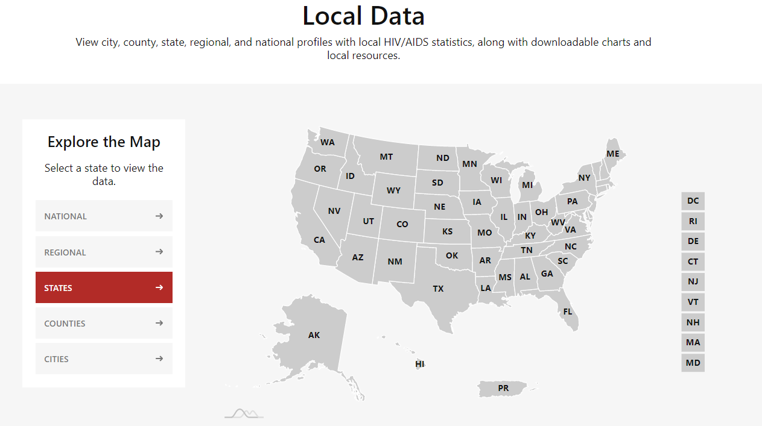
AIDSVu Local Data
Notes:
AIDSVu is an interactive online mapping tool that visualizes the impact of the HIV epidemic on communities across the United States to increase disease awareness and promote data-driven public health decision-making.
AIDSVu is presented by Emory University’s Rollins School of Public Health in partnership with Gilead Sciences, Inc. and the Center for AIDS Research at Emory University (CFAR).
The site utilizes data from the Centers for Disease Control and Prevention (CDC), local health departments, and other high-quality sources to allow users to explore the HIV epidemic at the state-, county-, and ZIP Code-levels. The map visualizes HIV-related data by race/ethnicity, sex, age, and transmission category, and shows how HIV is related to various social determinants of health, such as high school education, poverty, and housing.

Slide 33
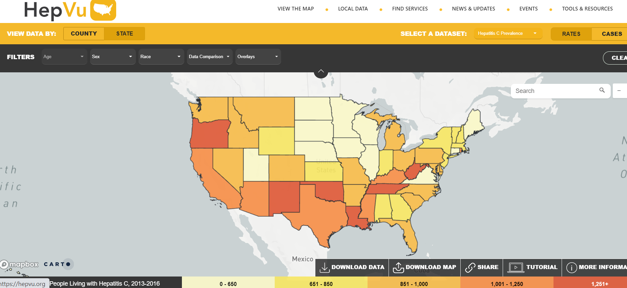
HepVu Map
Notes:
HepVu is an online platform that visualizes data and disseminates insights on the viral hepatitis epidemic across the U.S. HepVu’s mission is to make data widely available, easily accessible, and locally relevant to inform public health decision-making.
HepVu is a Powered By AIDSVu project presented by the Rollins School of Public Health at Emory University in partnership with Gilead Sciences, Inc.
Limited data is one of the most critical gaps in our national response to viral hepatitis. Though deaths associated with Hepatitis C continue to surpass the total combined number of deaths from 60 other reportable infectious diseases – including HIV, pneumococcal disease, and tuberculosis – the public health surveillance system for Hepatitis C is not as robust or extensive as it is for other infectious diseases like HIV. This makes it challenging to understand the scope of the Hepatitis C epidemic in the U.S. and develop tailored strategies to improve access to screening, treatment, and prevention services.

Slide 34
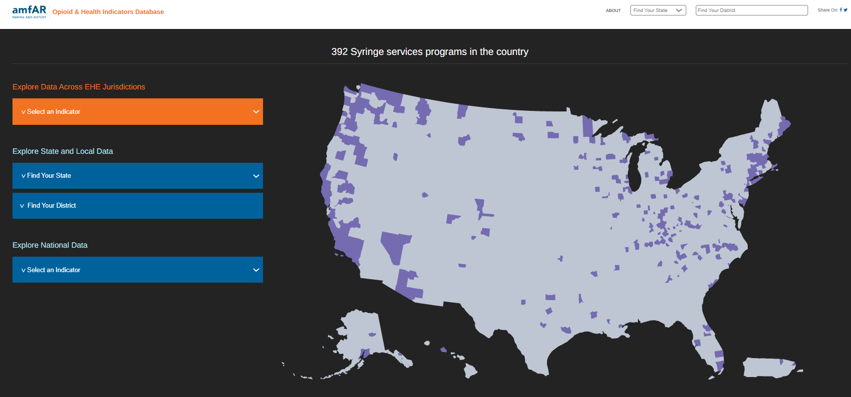
amfAR Opioids & Health Indicators Database
Notes:
amfAR's Opioid & Health Indicators database is a free web platform designed to support communities, lawmakers, and advocates in making informed decisions about the opioid epidemic and its impact on HIV and hepatitis C. The site is a window into the opioid epidemic unfolding in every American's backyard—it provides local to national statistics using reliable data sources on new HIV and hepatitis C infections, opioid use and overdose death rates, and the availability of services like drug treatment programs and syringe exchange services. In addition, users can examine data at the state or the county levels to see the differential impact of the opioid epidemic by state or within states.
All data and reports are from publicly available sources and are free to be used by users for any purpose. More information on data methodology can be found in the Data Sources section.
This tool was funded and internally developed by amfAR.

Slide 35
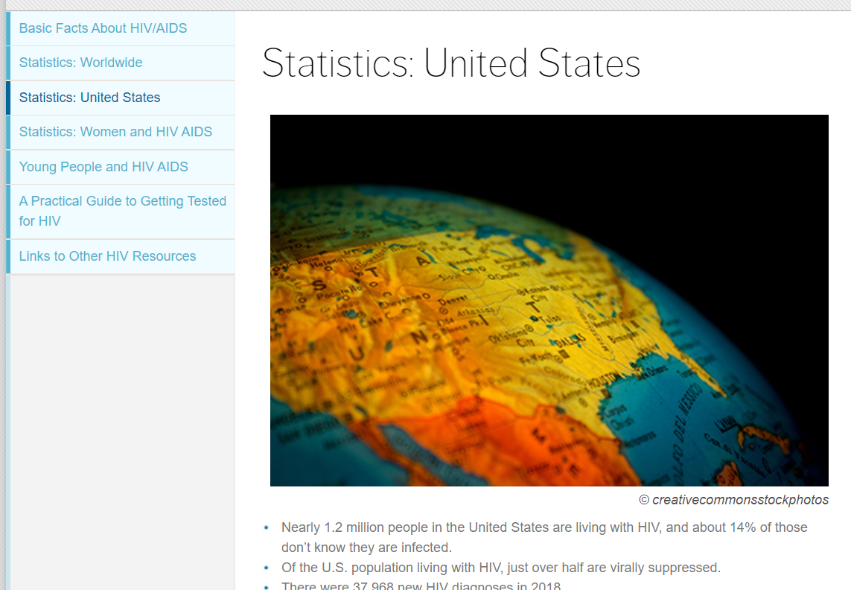
amfAR HIV Statistics
Notes:
amfAR, The Foundation for AIDS Research, is one of the world’s leading nonprofit organizations dedicated to the support of AIDS research, HIV prevention, treatment education, and advocacy. Since 1985, amfAR has invested nearly $600 million in its programs and has awarded more than 3,500 grants to research teams worldwide.
amfAR uses data from the US Centers for Disease Control and Prevention and the US Census Bureau.

Slide 36
Minority Health Social Vulnerability Index
Notes:
The Centers for Disease Control and Prevention (CDC) and U.S. Department of Health and Human Services (HHS) Office of Minority Health developed the Minority Health Social Vulnerability Index (SVI) to enhance existing resources to support the identification of racial and ethnic minority communities at greatest risk for disproportionate impact and adverse outcomes due to the COVID-19 pandemic. Given evidence on common factors contributing to social vulnerability, the MH SVI could potentially be applied to other public health emergencies.
Click on the following link to access the Minority Health SVI through the CDC's website.

Slide 37
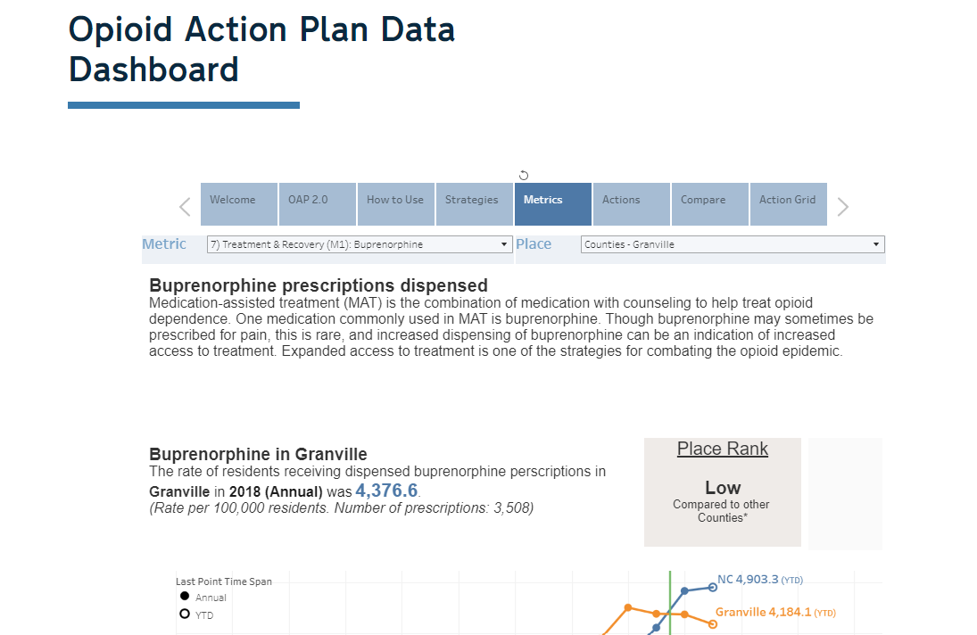
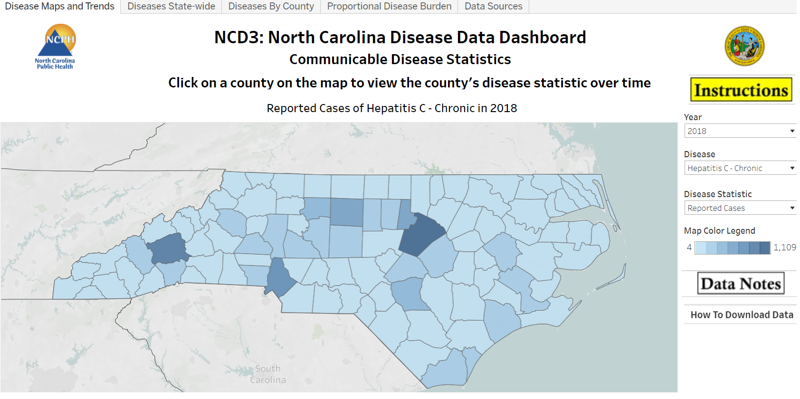
Jurisdictional Data Dashboards
Several jurisdictions have put together web-based data portals to track data related to opioid use and overdose. Check with your public health department to see what resources might be available.
Notes:
North Carolina Opioid Action Plan Data Dashboard: https://www.ncdhhs.gov/about/department-initiatives/opioid-epidemic/opioid-action-plan-data-dashboard
NCD3: North Carolina Disease Data Dashboard: https://public.tableau.com/views/NCD3NorthCarolinaDiseaseDataDashboard/DiseaseMapsandTrends?%3Aembed=y&%3AshowVizHome=no&%3Adisplay_count=y&%3Adisplay_static_image=y&%3AbootstrapWhenNotified=true

Slide 38
Section 2 Harm reduction values and principles

Slide 39
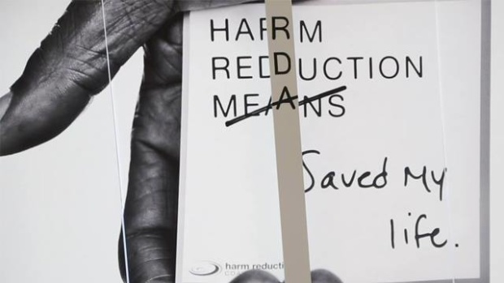
Harm reduction is a practical public health approach that reduces the negative consequences of drug use and sex work and promotes the health of people and communities.

Slide 40
Harm Reduction Values
Health and Dignity
Participant-
Centered
Participant Leadership
Participant Autonomy
Pragmatism and Realism
Sociocultural Complexity
Notes:
Health and Dignity: People deserve access to low-barrier, affordable, nonjudgmental healthcare services regardless of whether they are using drugs, involved in sex work, involved in the criminal-legal system, or experiencing homelessness. Quality of life, well-being, and participant-identified goals are how we gauge whether interventions are successful—not abstinence from drugs or cessation of sex work.
Participant-Centered: Services are nonjudgmental and non-coercive. It is not assumed that “one size fits all”; there is space for participants to identify their own goals and expectations.
Participant Leadership: People who use drugs, people doing sex work, people involve in the criminal-legal systems, and people experiencing homelessness are actively involved in creating the programs and policies intended to serve them. They are hired, sit on boards, and are paid for their expertise.
Participant Autonomy: People who use drugs, people doing sex work, people involve in the criminal-legal systems, and people experiencing homelessness make their own decisions. People change when they are ready for change, not on a provider’s timeline.
Pragmatism and Realism: Harm reduction does not ignore the potential risks and harms associated with drug use or sex work. Instead, harm reduction understands these risks in the context someone’s life, experiences, and priorities.
Sociocultural Complexity: Racism, sexism, homophobia, classism, ableism, discrimination, and experiences of trauma affect people’s vulnerability to and resilience against drug-related harms.
Programs based in harm reduction are characterized by low-barrier, low-threshold, mutually respectful services designed to “meet people where they’re at.” Harm reduction programs are a common entry point to services and care for highly stigmatized people or those who are distrustful of the medical system. They provide an alternative to abstinence-based programs by accepting that people who use drugs or people doing sex work are deserving and capable of caring for themselves and their loved ones. This allows someone the opportunity to take steps to actively protect their own health and the health of their communities while maintaining personal control and agency over their behaviors (including sex work or drug use).

Slide 41
Harm Reduction Principles for Drug User Health
Accepts that drug use is a common and enduring human practice and works to address and reduce related harms, rather than ignoring or condemning them.
Understands drug use as a complex, multi-faceted phenomenon that encompasses a continuum of behaviors from severe use to total abstinence and acknowledges that some ways of using drugs are clearly safer than others.
Establishes quality of individual and community life and well-being—not necessarily cessation of all drug use—as the criteria for successful interventions and policies.
Calls for the non-judgmental, non-coercive provision of services and resources to people who use drugs and the communities in which they live in order to assist them in reducing attendant harm.
Notes:
https://harmreduction.org/about-us/principles-of-harm-reduction/

Slide 42
Ensures that people who use drugs and those with a history of drug use routinely have a real voice in the creation of programs and policies designed to serve them
Affirms people who use drugs (PWUD) themselves as the primary agents of reducing the harms of their drug use and seeks to empower PWUD to share information and support each other in strategies which meet their actual conditions of use
Recognizes that the realities of poverty, class, racism, social isolation, past trauma, sex-based discrimination, and other social inequalities affect both people’s vulnerability to and capacity for effectively dealing with drug-related harm
Does not attempt to minimize or ignore the real and tragic harm and danger that can be associated with illicit drug use

Slide 43
Harm Reduction History
Harm reduction’s roots can be traced back to many social justice movements throughout the twentieth century, including the Black liberation movement, the reproductive justice movement, the disability rights movement (“Nothing about us without us”), and HIV/AIDS activism.¹ Health and human rights for people who use drugs is a social, political, and economic issue.
Syringe service programs first started in the Netherlands—through advocacy by drug users—in the 1970s/1980s, with support from the local health department, in response to a hepatitis B outbreak among PWID.²
In the 1980s and ‘90s, drug users and allies in the United States began informal and underground SSPs in response to the HIV epidemic, despite legal risks.³
Despite a 1984 CDC recommendation that syringe access would protect Americans from HIV, since 1988, U.S. law has prohibited the use of federal funds for these supplies.⁴ The Biden Administration’s 2021 American Rescue Plan Act allotted $30 million for syringe purchasing despite the ban.⁵
Notes:
The politicization of drug user health, through racist and classist policies and enforcement practices, led to the formation of harm reduction as a social justice movement in addition to a public health framework. Involvement and leadership of people with lived experience is integral for both social change and improved public health.
”Harm Reduction Movement History,” National Harm Reduction Coalition, https://harmreduction.org/movement/
van Santen, D.K., Coutinho, R.A., van den Hoek, A. et al. Lessons learned from the Amsterdam Cohort Studies among people who use drugs: a historical perspective. Harm Reduct J 18, 2 (2021). https://doi.org/10.1186/s12954-020-00444-6
Des Jarlais DC. Harm reduction in the USA: the research perspective and an archive to David Purchase. Harm Reduct J. 2017;14(1):51. Published 2017 Jul 26. doi:10.1186/s12954-017-0178-6
https://www.cdc.gov/ssp/ssp-funding.html
“Drug Policy and the First 100 Days of the Biden-Harris Administration: Important Steps Forward and What’s Needed Next.” https://www.lac.org/news/drug-policy-and-the-first-100-days-of-the-biden-harris-administration-important-steps-forward-and-whats-needed-next.

Slide 44
Social Determinants of Health for PWUD
Structural: Racism, poverty, access to care, stigma and discrimination
Social determinants of health are social, economic, and political circumstances that influence individual and community health status.
Comprehensive harm reduction addresses drug use as well as the environment in which someone is using drugs.
Experiences of discrimination and trauma related to race and gender identity, class, family history, and incarceration influence people’s drug use behaviors and access to care.
Within a harm reduction framework, providers’ responsibility is to acknowledge and address barriers in order to promote stability, safety, and health for their communities.
Community: Lack of housing, availability of substances
Interpersonal: Substance use, mental health
Individual: Infections, wounds, overdose
Notes:
Social determinants of health are often grouped into five categories:
Economic stability
Education access and quality
Healthcare access and quality
Neighborhood/location and built environment
Social and community context
Awareness of individual- and community-level social determinants of health is important for providing comprehensive care. Understanding people as whole human beings is the first step to providing comprehensive, holistic care.
https://health.gov/healthypeople/objectives-and-data/social-determinants-health

Slide 45
Harm reduction programs for drug user health:
Provide of services to people in active use, without the expectation that they stop using drugs.
Provide supplies and resources to people who use drugs, so that they can use and live as safely as possible.
Prioritize non-judgmental, non-stigmatizing, non-coercive, strengths-based, and mutually respectful engagement with people who use drugs.
Acknowledge the harms associated with drug use, while presenting accurate and complete information about ways to reduce these harms much as possible.
Notes:
Harm reduction strategies are accessible for people with all kinds of drug use practices—everything from chaotic use to abstinence. Whether it’s learning to identify opioid overdose and administer naloxone as a bystander or making goals to reduce supply reuse and sharing, there are many practical ways for people and communities to address and reduce risks related to substance use disorder and unregulated drug supply. A harm reduction approach also ensures that relationships between participants and programs can evolve as someone’s use changes, while maintaining the connection.

Slide 46
Section 3 Drug use and harm reduction

Slide 47
Why do people use drugs?
Notes:
If facilitating a group training:
Use this slide to prompt responses from participants.

Slide 48
People Use Drugs for a Variety of Reasons
Curiosity
“Getting well”
Pain management (physical, psychological, emotional, spiritual)
“Social lubricant”
Calm down, ease anxiety
Fun
Protection
SUD, compulsive use
Stress relief
Bonding with friends or family
Spiritual practices
Social norms, peer pressure
Increase sexual pleasure
Boredom
Notes:
Because there is no one reason why people use drugs, programs and providers need to be able to provide and adapt services for a wide variety of experiences and expectations. A harm reduction approach allows people to engage and remain connected to services if their drug use changes. Even someone using chaotically or experiencing substance use disorder can make rational decisions about drug use and health. Understanding someone’s motivations around and attachment to their drug use is necessary for providing nonjudgmental, strengths-based care—a foundation of harm reduction work.

Slide 49
Visualizing Drug Use
Notes:
Traditionally, our understanding of drug use has been based on absolutes: either someone is “clean,” or they aren’t; either someone is “addicted,” or they aren’t. However, the vast majority of people who engage in drug use do not develop substance use disorder. We see proof of this all around us—for example, going out for an occasional drink after work doesn’t mean someone needs residential treatment for alcohol use disorder. Rather than moving in a straight and ever-worsening line (image on the left, the idea that someone is “hooked for life” after using a drug once), drug use is changeable and situational (image on the right). Someone might smoke more cigarettes when they’re stressed at work, or use more opioids when pain flares up, or drink more when celebrating with friends. To save money, or to manage tolerance and dependence, or to avoid legal or health repercussions, a person might reduce their drug use. Protective factors, like access to healthcare and harm reduction services and close, supportive social relationships, help people through those transitions safely.

Slide 50
Drug Use Continuum
Experimental
Social/Ritual
Situational
Binge Use
Misuse
Dependence
Chaotic
Notes:
A harm reduction framework understands drug use on a continuum from abstinence (no drug use at all) to chaotic or problematic use (use that is compulsive and negatively affecting one’s life). There are many ways to interact with a drug within that continuum:
Experimental: trying a drug, seeing how it feels
Social/ritual: using drug(s) in social settings, like going to a bar with friends or using cocaine at parties
Situational: using drugs in specific situations, like champagne at weddings, smoking a cigarette while mourning a loved one, or using methamphetamine to enhance sex
Binge use: using a large amount of drug(s) at one time, like “going all out” for a weekend celebration or having several more drinks than usual in one night
Dependence: habitually using drug(s) because of physical or mental reliance, “not feeling right” without it, may experience withdrawal symptoms
Chaotic or problematic use: drug(s) use that feels unmanageable or uncontrollable and is having a negative impact on one’s life

Slide 51
Drug, Set, and Setting
Norman Zinberg, an American psychiatrist and researcher, conducted several studies on drug use and substance use disorder in the 1970s and 1980s.
He found three major factors that shape drug use behavior:
The Drug: the type of drug, the amount, the route of administration, the frequency of use, etc.
The Set: the mindset or attitude toward drug use (the “why”)
The Setting: the context when using the drug—where, when, and with whom
Notes:
Zinberg’s work highlighted the importance of holistic, person-centered approaches to drug use and substance use disorder. He studied social use patterns of drugs and how drug use evolved over time—and discovered that among people who used drugs socially, few would go on to use long-term or develop problematic use. Most people aged out of their drug use, got bored with the same routines, and developed other priorities.
He identified three major factors that influenced someone’s relationship to their drug use and how their use would develop over time—basically, where they would tend to fall on the “abstinence-to-chaotic use” spectrum.
“The drug” refers to the type of drug, the amounts used, the route(s) of administration, how often someone uses, and other preferences or practices.
“The set” is the mindset or attitude with which someone approaches their drug use—these are the “whys” from the beginning of this training section.
“The setting” refers to the context or factors surrounding use—using alone or in a group, before work or on the weekends, with a romantic partner?
Zinberg found that the combination of these factors would dictate and could maybe predict the potential for and severity of continued use. Understanding the complexity around someone’s drug use practices—their drug, set, and setting—is key to developing relationships and providing relevant, helpful support.

Slide 52
Another example of “drug, set, and setting” are the experiences of veterans returning to the US after the Vietnam War
Lee Robins, American academic and researcher of social science in psychiatry, 1974
Her studies examined heroin use among veterans after they completed service
She and her team found that many people did not continue using heroin post-deployment without requiring treatment, even though they had previously shown signs of physical dependence.
They found high rates of heroin use (34%) and symptoms of heroin dependence (20%) among US soldiers while serving in Vietnam. In the first year after returning to the United States only 1% became re-addicted to heroin, although 10% tried the drug after their return.
Most participants cited a change in stress level, change in environment, and familial or social perceptions of drug use as their reasons for discontinuing their use.
Notes:
If facilitating a group training:
What other circumstances might encourage situational drug use?

Slide 53
Adverse Childhood Experiences
Adverse childhood experiences (ACEs) are potentially traumatic events or environmental factors that undermine safety and stability in childhood, including:
Experiencing and/or witnessing abuse, violence, or neglect
Having a family member or loved one die by suicide
Growing up in a household where people misuse substances or experience untreated mental health issues
Separation from a parent or other household member due to incarceration
Exposure to and experience of structural violence
Notes:
https://www.cdc.gov/violenceprevention/aces/resources.html?CDC_AA_refVal=https%3A%2F%2Fwww.cdc.gov%2Fviolenceprevention%2Facestudy%2Fresources.html
Dube SR, Felitti VJ, Dong M, Chapman DP, Giles WH, Anda RF. Childhood abuse, neglect, and household dysfunction and the risk of illicit drug use: the adverse childhood experiences study. Pediatrics. 2003 Mar;111(3):564-72. doi: 10.1542/peds.111.3.564. PMID: 12612237.
Anda RF, Brown DW, Felitti VJ, Dube SR, Giles WH. Adverse childhood experiences and prescription drug use in a cohort study of adult HMO patients. BMC Public Health. 2008 Jun 4;8:198. doi: 10.1186/1471-2458-8-198. PMID: 18533034; PMCID: PMC2440750.
Dube SR, Miller JW, Brown DW, Giles WH, Felitti VJ, Dong M, Anda RF. Adverse childhood experiences and the association with ever using alcohol and initiating alcohol use during adolescence. J Adolesc Health. 2006 Apr;38(4):444.e1-10. doi: 10.1016/j.jadohealth.2005.06.006. PMID: 16549308.
Dube SR, Anda RF, Felitti VJ, Edwards VJ, Croft JB. Adverse childhood experiences and personal alcohol abuse as an adult. Addict Behav. 2002 Sep-Oct;27(5):713-25. doi: 10.1016/s0306-4603(01)00204-0. PMID: 12201379.

Slide 54
ACEs and Drug User Health
A 2003 study found that each adverse childhood experience increases the likelihood of illicit substance use between two- and four-fold.
Early use of alcohol, higher risk of chaotic alcohol use as an adult, and prescription drug use are correlated with experiencing four or more ACEs.
About one in six US adults report experiencing four or more ACEs before age 17.
Women and Black and Indigenous people of color are more likely than the general population to have experienced four or more ACEs.
Notes:
Dube SR, Felitti VJ, Dong M, Chapman DP, Giles WH, Anda RF. Childhood abuse, neglect, and household dysfunction and the risk of illicit drug use: the adverse childhood experiences study. Pediatrics. 2003 Mar;111(3):564-72. doi: 10.1542/peds.111.3.564. PMID: 12612237.

Slide 55
Substance Use Disorders
Substance use disorder (SUD) is a clinically diagnosed pattern of symptoms stemming from continued drug use or the inability to stop using, despite experiencing physical, mental, and/or social consequences from use.
Symptoms of SUD include cravings and unmanageable urges to use, increased tolerance, and physical/mental withdrawal symptoms.¹
Withdrawal from certain drugs, like alcohol and benzodiazepines, can be severe and include potentially fatal symptoms like seizures, hallucinations, and depression—so people should always have medical supervision when tapering off these drugs.
For opioid users with physical dependence, withdrawal can include flu-like symptoms and be incredibly painful.
People with opioid use disorder (OUD) will often use not to get “high,” but to “stay well,” or prevent the debilitating symptoms of opioid withdrawal.
Notes:
It is important to note that physical and/or mental dependence can be a symptom or criterion of substance use disorder (including alcohol use disorder and opioid use disorder), but that dependence does not equal SUD or addiction in all situations. Someone who takes medications for mental healthcare, medications for opioid use disorder, or maintains a pain management regimen may be dependent on their medication, but may not have other symptoms of unmanageable or chaotic use that characterize SUD.
https://www.psychiatry.org/patients-families/addiction
https://medlineplus.gov/ency/article/000949.htm
https://www.healthline.com/health/alcoholism/withdrawal

Slide 56
Drug user health and safety

Slide 57
Common Types of Drugs
Cannabis
Cannabis flower, hash, THC and CBD extracts, dabs, shatter, tinctures, etc. (also hallucinogenic)
Opioids
Opium, heroin (powder and tar), morphine, codeine, fentanyl, carfentanyl, oxycodone (Oxycontin, Percocet)
Sedatives
Barbiturates (Amytal, Seconal), methaqualone (Quaaludes), benzodiazepines (diazepam/Valium, lorazepam/ Ativan, clonazepam/Klonopin, alprazolam/Xanax)
Stimulants
Powder cocaine, crack cocaine, methamphetamine, illicit and prescription amphetamines (Ritalin, Dexedrine, Adderall)
Psychedelics, Disassociatives
Acid/LSD, psilocybin (shrooms), mescaline, peyote, MDMA/MDA (ecstasy, molly), ketamine
Other Drugs
Nicotine and tobacco products (chew, snuff, vapes), caffeine products (coffee, soda, energy drinks), alcohol
Notes:
Access to and quality of illicit drugs vary around the world. Availability of certain types of drugs depends on geographic region, trade and transportation routes, climate and agriculture, regulation and criminalization, wealth and disposable income (how much money the average person is able to spend on drugs), and other social and political influences. The drug types listed here are common in the United States but many others may be found in markets around the country—for example, new research chemicals and “designer drugs” are identified all the time.

Slide 58
Routes of Administration
Oral, swallowing, ingestion
Inhaling, smoking, freebasing
Snorting, intranasal, intramucosal (mucus membranes)
Booty bumping, plugging, boofing
Intravenous injection (IV use)
Intramuscular injection (IM use)
Subcutaneous injection (skin popping)

Slide 59
Strategies for Safer Drug Use
Oral Use
Mix your own drinks
Alternate alcohol with water
Eat something to line your stomach
Carbonated drinks cause intoxication faster than uncarbonated ones
Inhalation
Use your own pipes and stems
Wipe mouthpieces down between uses
Use a filter if smoking crack cocaine (Chore Boy, copper screen), burn off chemicals before use
Don’t hold in meth smoke—it won’t help the high and can damage your lungs
Snorting
Rinse nose with water or saline before use
Use a new, personal straw or rolled Post-It note instead of a dollar bill or shared straw
Avoid snorting if you have a cold or sinus infection
Apply ointment to nostrils after use to prevent damage and bleeding
Booty Bumping
Use a needle-free syringe to insert the drug solution
Don’t go too far—less than an inch!
Use lube if it’s painful
Go slow—drugs are absorbed quickly in the rectum, a little goes a long way

Slide 60
Strategies for Safer Injection
Intravenous
Use a tie or tourniquet to help find veins
Avoid injecting in neck, groin, and wrists
Use the smallest possible needle gauge, and always a new syringe, to reduce tissue damage
Rotate sites, allow tissue to heal between injections
Intramuscular
Intramuscular injection is most appropriate for thicker, more viscous solutions, like steroids and hormones
Don’t draw from a shared supply
Subcutaneous
Subcutaneous injections can easily lead to abscesses—clean your skin well prior to injection, take care of injection sites, and rotate locations
For all injections:
Use sterile injection equipment every time; don’t share or reuse supplies; clean injection site before use; use a test shot and inject slowly, and rotate injection sites.

Slide 61
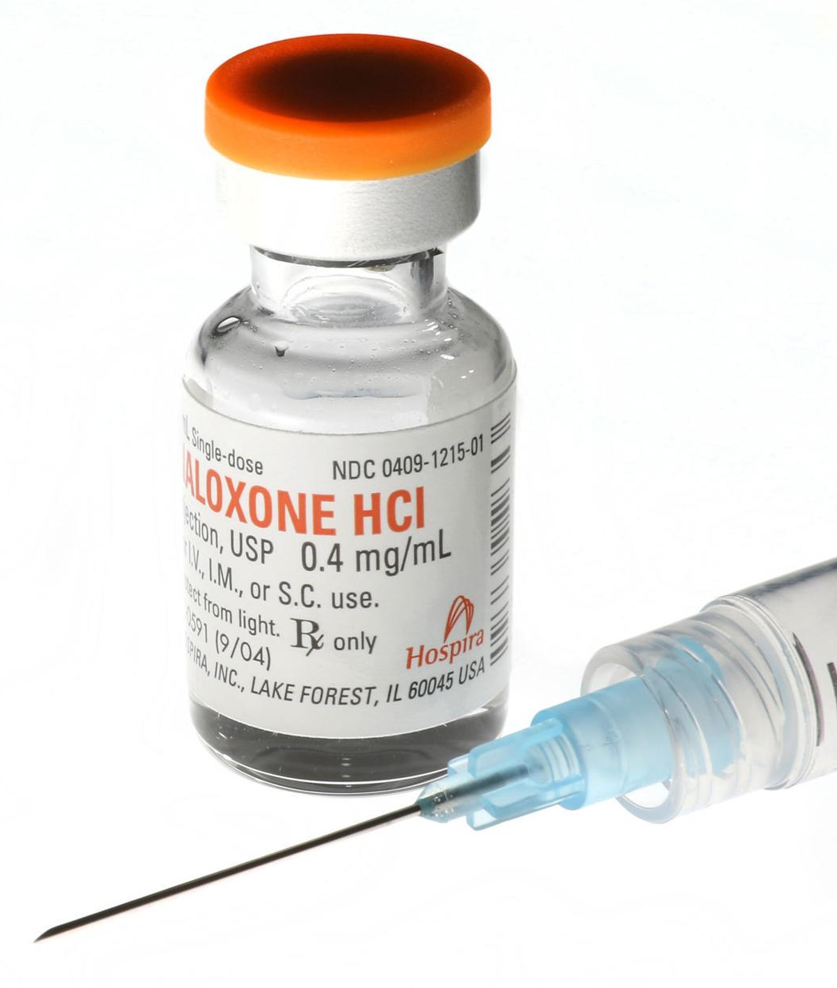
Always Have Naloxone
An illicit drug supply is an unregulated drug supply. Even when getting drugs from a trusted source, check your supply with fentanyl test strips or other drug-checking tools. Make sure naloxone is available and that someone is able to administer it in case of opioid poisoning.
Notes:
Illicit drug markets make quality control very difficult. Fentanyl and strong opioid analogues can be mixed with other substances—other opioids, as well as stimulants like meth and cocaine. People who don’t usually use opioids (“opioid-naïve”) have less tolerance and may be more vulnerable to opioid overdose from unintentional fentanyl exposure than opioid users. Assume that there might be fentanyl (and other potent opioid analogues) in any illicit drugs—don’t use alone, make naloxone available, go slowly, and use a test dose or shot.

Slide 62
Know your substances, how they interact, and make sure to use with others or let people know what you’re taking.
Notes:
Everyone, even people experiencing substance use disorder, can make rational decisions about their drug use—including by taking safety precautions, or deciding not to use at all. Using intentionally—having a plan, knowing how much you will use, knowing who else will be there, being prepared to manage side effects and aftercare—can prevent harms and help establish/maintain healthy boundaries.

Slide 63
Managing Drug Use Risks
Drug
Type of drug(s)
Route(s) of administration
Potency and adulterants
Know your source
Set
Timeline
Mindset and emotional state
Expectations of drug use
Setting
Environmental or situational risks
Location
Involvement of partner(s)
Access to sterile supplies, legal landscape
Notes:
Using the framework developed by Norman Zinberg—
Drug
The drug(s) being used, potency and quality, how much is used, method of use, “cuts” or adulterants in the drug(s)
“Quality control” is difficult-to-impossible when the drug supply is unregulated
However, programs and providers can collect and share information about local/regional drug supply, including “bad bags”/strong batch information or areas that have reported a high number of fentanyl-related overdoses that might be associated with a specific drug supply
Prescription medications (MOUD/MAT regimens, medications not-used-as-prescribed) can make it easier to determine potency and prevent contamination
Set
The mindset or attitude with which someone approaches their drug use
If someone is in withdrawal and trying to get well, or using in public and afraid of arrest or harassment, it may affect their process of preparing and administering (for example, reusing a syringe instead of waiting to be able to pick one up from an SSP)
People, even people experiencing substance use disorder, can make rational decisions about their drug use. Using intentionally—having a plan, knowing how much you will use, knowing who else will be there, being prepared to manage side effects and aftercare—can prevent harms and help establish/maintain healthy boundaries.
Setting
The context or factors surrounding use, including environmental or situational circumstances
Providers should consider the setting(s) of drug use when talking to someone about their use and ways to reduce risks
Not having a safe place to use, including a clean surface for preparation, can affect preparation and administration and create additional risks
Having a partner facilitate your use (including having a partner perform injections) can reduce control over individual use; however, using alone can create other risks
Create safer environments where people can use, identify policy changes that would reduce environment risks, address stigma towards/discrimination and stigma against drug users

Slide 64
Supporting Comprehensive Harm Reduction
First and foremost, treating all people with respect for their dignity and autonomy
Syringe access through SSPs, pharmacies, vending machines, and other sources
Flexible, low-barrier access to medications for opioid use disorder (MOUD)
911 Good Samaritan laws that protect people experiencing and responding to an overdose from criminal penalties
Drug-checking tools like fentanyl test strips and mass spectrometry testing, community naloxone trainings
Mental health crisis center and trauma-informed emergency response services
Wrap-around mobile services to improve connections to and retention in care
Peer leadership and support services
Housing First initiatives to increase low-barrier housing for people who use drugs
Community navigation for health insurance, medical and social service connections, long-term care, and other resources
Sharing honest, evidence-based information with people who use drugs and people who do sex work, without judgment
Co-located primary care, including wound care, reproductive health services, and vaccination
Notes:
The potential risks identified on the previous slide—and others—can change day to day and from one user to another. Supporting comprehensive, person-centered care requires different types of interventions and services within different parts of society. Prioritizing participant involvement and developing meaningful relationships with community members ensures that services can evolve and maintain relevance even as drug trends change.
Harm reduction programs will always look different from place to place, because they intentionally develop to respond to local needs, assets, and drug use practices. Some programs may veer more toward medical services—providing HIV, viral hepatitis, and STI screening and treatment, wound care, street medicine teams, reproductive health services, and more. Other programs may collaborate more with local social service agencies to facilitate food pantries, clothing closets, community service and outreach, and other mutual aid supports. Investing in one-on-one relationships with participants or maintaining a Community Advisory Board can help identify priority services for co-location or connections to care.
According to CDC, people who participate in SSPs are five times more likely to enter SUD treatment than people who do not participate in these programs. When people feel safe and supported in their actions—”met where they’re at”—they are more likely to maintain ties to health services and to seek out compassionate, nonjudgmental providers and advocates if or when they want treatment.

Slide 65
Community Harm Reduction: Overdose Prevention
Strategies to prevent and respond to drug poisoning
Expand access to naloxone to reverse an opioid overdose, through pharmacies, co-prescribing, SSP and local health department distribution, public-access naloxone (like AEDs or fire extinguishers)
Provide training and education to people most like to be able to respond to an opioid overdose—namely people who use drugs and their social circles
Support legal protections for people experiencing and responding to drug-related emergencies, including Good Samaritan laws and amnesty for paraphernalia
Promote low-barrier MOUD as treatment or safe supply
Improve health for incarcerated people, including MOUD treatment and naloxone training and access
Notes:
How many overdoses occur in your community? Which of these strategies are currently available? What other strategies might be viable?

Slide 66
Community Harm Reduction: Supply Access
Strategies to prevent and respond to use-related harms
Collect and safely dispose of used syringes
Distribute new, sterile supplies for injection and other routes of administration
Distribute condoms, dental dams, and other safer sex supplies
Offer naloxone trainings and overdose reversal kits free-of-charge
Develop wound care services responsive to different routes of administration
Co-locate reproductive health services and contraceptive access
Offer PrEP and PEP regimens for HIV prevention; vaccines for hepatitis A&B, COVID-19, flu, and more
Provide HIV, viral hepatitis, and STI education, screening, and treatment
Notes:
In your experience, what do SSPs typically provide? What do they look like, or how are they structured? How are services delivered, what do interactions look like between participants and staff?

Slide 67
Think back to the Values Clarification activity— How are you feeling after this training? What have you learned? How have your opinions changed, or might they continue to change?
Notes:
Review the prompts from the Values Clarification activity. Knowing more about harm reduction and drug user health, have any of your thoughts or feelings changed?

Slide 68
What other questions do you have about drug user health and harm reduction?
Notes:
Do you have any final reflections? What do you wish had been included in this training? What else are you interested in learning about drug user health and harm reduction? What are your main take-aways? Do you have any ideas for next steps?

Slide 69
NASTAD thanks you for participating in this training! For more information or Drug User Health technical assistance, please contact DrugUserHealthTA@NASTAD.org.
Thank you!
Notes:
Do you have any final reflections? What do you wish had been included in this training? What else are you interested in learning about drug user health and harm reduction? What are your main take-aways? Do you have any ideas for next steps?

